Slide 1
Component Level Testing in a Hierarchical Architecture
Tom Clune¹
Natalie Patten^{1,2}, Ben Auer^{1,3}, Arlindo da Silva¹
¹ NASA Goddard Space Flight Center
³ Space Systems, LLC.
² SSAI, Inc.

Slide 2
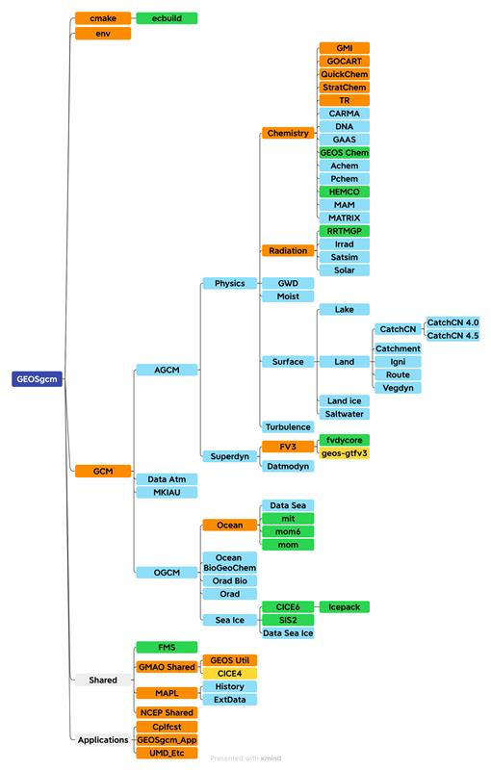
Background and Motivation: GEOS
GEOS is a highly configurable Earth System Model
Hierarchical system of modular components built on top of ESMF
Coupling based on standardized ESMF abstract data types
ESMF_State, ESMF_Field, ESMF_FieldBundle, ESMF_Geom, …
Each component has an import and an export state
And optionally an internal state
The MAPL infrastructure layer provides common services:
Allocation of fields and states
Connections between components
Automatic checkpoint & restart
Supported internally by software infrastructure team
Develop and maintain MAPL
Develop and maintain automated/CI tests
Help scientists troubleshoot weird errors

Slide 3
Background and Motivation
Gratifying/rewarding
Writing new code (procedures, classes)
Modifying reasonably clean code
Writing unit tests
Debugging my own clean code
Debugging other people’s legacy code
Modifying poorly written blobs of code
Finding workarounds for other software (esp. compilers)
To me, legacy code is simply code without tests.
- Michael Feathers
Unpleasant/discouraging

Slide 4
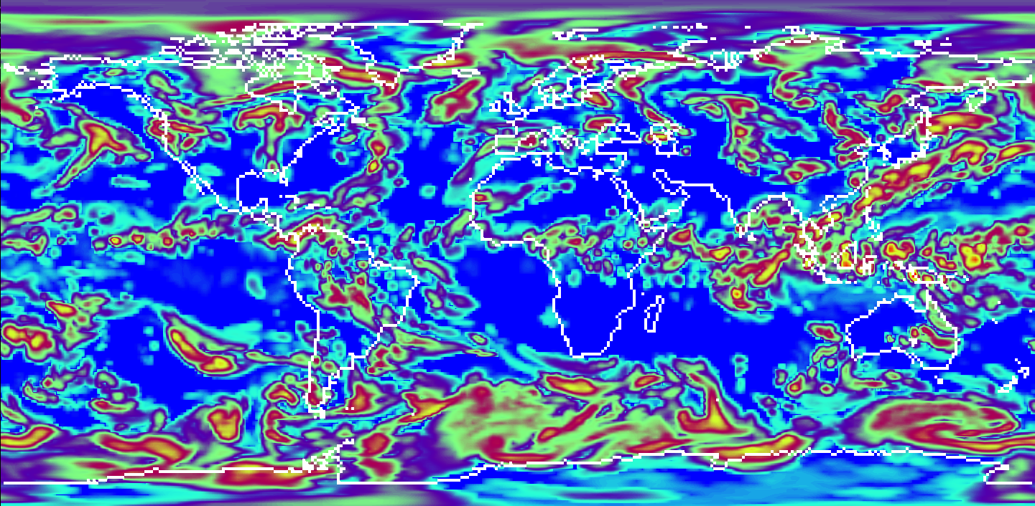
Story 1: Mysterious decomposition imprint
Ice Water Path
Defect: results show imprint of domain decomp
Details:
Very weak signal – mostly visible in “obscure” qtys.
Requires non-default moist physics option
Current GEOS CI is blind to this
Signal disappears with -O0 (Compiler bug?)
Status: Unresolved
Multiple people have spent weeks on this.
One took 5-week vacation. Coincidence?
C90 resolution; 4x4 face decomposition

Slide 5
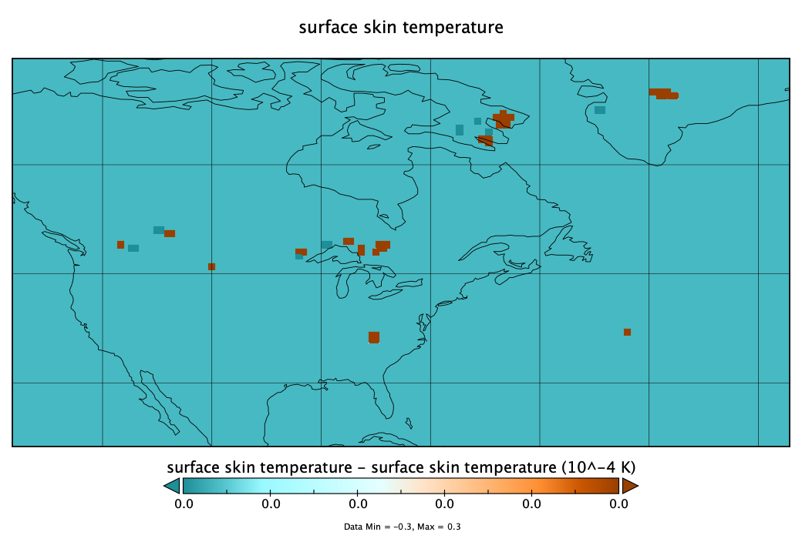
Story 2: Layout regression failure
Defect: layout regression
Details:
Does not fail for coarse resolutions
Requires $∆ ≤\sim 50 km$
Undetected by CI for months! (200 km)
Initial divergence is roundoff at isolated points in the domain.
Status: Unresolved
Image from A. Oloso

Slide 6
Existing GEOS testing: System Tests
Types of system tests
Does it build? Does it run?
Restart reproducibility (1 + 1 = 2)
Layout reproducibility (3x4 = 6x2)
Regression – no change to results
Scientifically equivalent results
What do failures tell us?
Maybe location for build/run failure
Maybe type of mistake to look for
Pros
Relatively good code coverage
Easy to maintain as model evolves
Cons
Poor isolation of defects
Relatively resource intensive
Compute, memory, BC’s, IC’s
GEOS
Warner Bros Entertainment
Cons
Poor isolation of defects
Notes:
Regression tests only done in nightly, not part of CI.

Slide 7
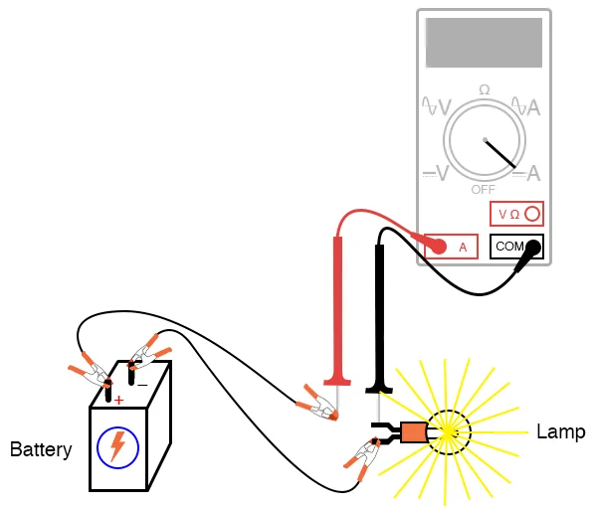
Existing GEOS tests: Unit tests
Unit test:
Does a procedure (SUT) produce expected output for specific inputs
What do failures tell us?
Defect in the SUT covered by the test
Pros
Excellent isolation of defects.
Fast execution (1000’s per second)
Cons
Poor coverage (in practice)
Labor intensive
Can be challenging to define/implement
Must be maintained as SUT evolves
SUT

Slide 8
How about component-level tests?
Standardized suite of tests applied to each model component
Layout reproducibility
Regression
…
Sidesteps the weakest aspects of system tests and unit tests
Collective coverage comparable to that of system tests
Regression failures localized to specific components
Resource efficient
Only test altered components
Fast execution, etc.
Notes:
Have wanted to implement something like this for many years.

Slide 9
A generic component-level testing framework?
All components have the same interface
Should be straightforward to develop a generic testing app that:
Expects an initial import state
Runs selected component
Compares resulting export state against expected import state
How to obtain imports and expected exports?
Custom (per-component) data provided by component maintainer?
Must be maintained manually as component evolves
Capture data from trusted execution of full system?
Already have state-level checkpoint/restart layer that seems well suited.
Practical – can leave scientists out of it
Somewhat analogous to approach used by other tools such as KGEN
Have wanted to try this for many years, but … other priorities …
Along came an intern (spring 2023)
Notes:
Have wanted to implement something like this for many years.

Slide 10
Leaf component: capturing functional characteristics
Parent
Component
MAPL infrastructure layer
Wraps execution of child run methods
Has access to import and export states
Can even access internal state
Provides component-level checkpoint/restart
Minor extension: support export state
MAPL
MAPL
Component
Import
Export
disk
$$i\overset{F}{⟶ }e\text{)}$$
Checkpoint
Archived:
import state before
export state after
Component as a function
Control
File
Notes:
Easy export state is same type as import & internal states.

Slide 11
Testing simple leaf component
Diff
Report
Parent
Component
Generic
Driver
MAPL
MAPL
MAPL
MAPL
Component
Component
Import
Export
disk
Import
Export
import state before
export state after
Control
File
Control
File
Test Mode
Compare expected export state from disk against export state from test
Capture Mode
Notes:
Easy export state is same type as import & internal states.

Slide 12
Non-leaf components
Parent
Component
Parent
Component
Treat children as part of component?
Pro: no extra machinery needed
Cons:
Weak isolation of defects
High-level components get “big”
Isolate component from children (dependencies)?
Capture children export states when run
Note: each might be called multiple times
Use data mocks during replay
Pro: proper isolation of defects
Cons: some extra machinery needed
Note: similar difficulties arise with callbacks
MAPL
MAPL
Component A
Component A
MAPL
MAPL
MAPL
MAPL
MAPL
MAPL
Child A
Child A
Child C
Child B
Child C
Child B
Notes:
Easy export state is same type as import & internal states.

Slide 13
Details details …
$${i^{c} }_{t=n} \overset{F^{c}}{⟶ }{e^{c} }_{t=n+1} \\ {(i^{c};q^{c})}_{t=n} \overset{F^{c}}{⟶ }{(e^{c};q^{c})}_{t=n+1} \\ {(i^{c};q^{c})}_{t=n} \overset{F^{c}}{⟶ }{({i^{c};e}^{c};q^{c})}_{t=n+1} \\ {(i^{c^{∗}};q^{c^{∗}})}_{t=n} \overset{F^{c^{∗}}}{⟶ }{({i^{c^{∗}};e}^{c^{∗}};q^{c^{∗}})}_{t=n+1}$$
$${i^{c} }_{t=n} \overset{F^{c}}{⟶ }{e^{c} }_{t=n+1} \\ {(i^{c};q^{c})}_{t=n} \overset{F^{c}}{⟶ }{(e^{c};q^{c})}_{t=n+1} \\ {(i^{c};q^{c})}_{t=n} \overset{F^{c}}{⟶ }{({i^{c};e}^{c};q^{c})}_{t=n+1} \\ {(i^{c^{∗}};q^{c^{∗}})}_{t=n} \overset{F^{c^{∗}}}{⟶ }{({i^{c^{∗}};e}^{c^{∗}};q^{c^{∗}})}_{t=n+1}$$
$${i^{c} }_{t=n} \overset{F^{c}}{⟶ }{e^{c} }_{t=n+1} \\ {(i^{c};q^{c})}_{t=n} \overset{F^{c}}{⟶ }{(e^{c};q^{c})}_{t=n+1} \\ {(i^{c};q^{c})}_{t=n} \overset{F^{c}}{⟶ }{({i^{c};e}^{c};q^{c})}_{t=n+1} \\ {(i^{c^{∗}};q^{c^{∗}})}_{t=n} \overset{F^{c^{∗}}}{⟶ }{({i^{c^{∗}};e}^{c^{∗}};q^{c^{∗}})}_{t=n+1}$$
$${i^{c} }_{t=n} \overset{F^{c}}{⟶ }{e^{c} }_{t=n+1} \\ {(i^{c};q^{c})}_{t=n} \overset{F^{c}}{⟶ }{(e^{c};q^{c})}_{t=n+1} \\ {(i^{c};q^{c})}_{t=n} \overset{F^{c}}{⟶ }{({i^{c};e}^{c};q^{c})}_{t=n+1} \\ {(i^{c^{∗}};q^{c^{∗}})}_{t=n} \overset{F^{c^{∗}}}{⟶ }{({i^{c^{∗}};e}^{c^{∗}};q^{c^{∗}})}_{t=n+1}$$
Idealization: exports (e) are a function of imports (i)
Most components have internal state (q)
Some components modify imports (cheat!)
Structure of states depends on coupling context: $c^{∗}≠c$
Notes:
Lots of other little problems as well.

Slide 14
Unfortunately, context matters
Structure of import and export state depends in part on coupling context within wider system:
Some exports are “optional”. Only allocated & computed if connected to another component.
Some exports are re-exports from children. External specs.
Some import bundles are elastic – servicing other components on request:
E.g., DYN component has an import field bundle for tracers. Contents determined by advection requests in other components.
Parent component is allowed to modify child component’s control flags and parameters.
I/O?
Difficulty: restart files are not used to define structure of component states
Options:
Create capability to construct states from restart; overwrite “usual” states (easy)
Capture all events that impact state in checkpoint have restart extend states accordingly (hard)

Slide 15
Current status
Prototype developed by intern, Natalie Patten, in Spring 2023
Added MAPL runtime option to capture component states before and after Nth time step
Added required capabilities to MAPL checkpoint/restart layer
Created small python layer to extract “thin” subset for column components
E.g., just keep a 4x4 set of columns out of a high-res run
Created new standalone component test driver
Initialize and run component from DSO and archived ESMF states
Writes computed states back to disk
nccmp used to compare expected and found results.
Works for simple leaf components

Slide 16
Summary
Components based upon standard ESMF interfaces are conducive to generic CI testing
Basic capability has been demonstrated with MAPL2
Lots of difficulties encountered
Many remain
Some may require significant infrastructure changes
MAPL3 will be a major redesign (motivated by somewhat unrelated concerns)
Expect (hope) to include necessary bells & whistles to robustly handle all GEOS components
Will explore option of capturing “state-altering” events during initialization

Slide 17
Glossary
ESMF Earth System Modeling Framework
GMAO Global Modeling and Assimilation Office
GEOS Goddard Earth Observing System model
MAPL Modeling and Applications Layer
SUT system under test

Slide 18
Horror Story 1: Atmosphere-Ocean General Circulation Model and Data Assimilation System Version 2 (GEOS-S2S-2)
Production system ran for 180 simulated years without issue.
Continuation runs with same configuration reliably failed
Ultimate cause: negative salinity
Difficulties
Routine checking implemented but required 2 switches. Only one was activated.
Debug flags that should help were not propagated to ocean (external component)
Fortunately resolved in late October.
S2S

Slide 19
Along comes an intern …
Have wanted this functionality for years, but priorities never aligned
Add option to checkpoint procedure to save export state
Instrument MAPL run_child() with new control logic
If capture mode and on targeted timestep do super-checkpoint
Import and Internal state before
Internal and Export state after
Write MAPL driver program
Config file to specify
DSO of targeted component
Path to super-checkpoint
Initialize & Run component from saved super-checkpoint
Checkpoint “new” internal and export states
Write python layer to diff saved vs new states
Phase I (support simple leaf components) was expected to be straightforward. Lots of surprises encountered.
Phase II was meant to be extend phase I to include support for child components and callbacks.

