Slide 1
Preparing Data for Analysis with VAPOR Translating model data into a VAPOR Data Collection (VDC)
John Clyne, Alan Norton
National Center for Atmospheric Research
Boulder, CO USA
Korean Supercomputing Conference
Oct 10, 2012
This work is funded in part through U.S. National Science Foundation grants 03-25934 and 09-06379, and through a TeraGrid GIG award, and with support from the Korean Institute for Science and Information Technology (KISTI)
Notes:
Provide enough information so that you know what the tool is capable of

Slide 2
Introduction & Outline
The vaporgui application can import ``foreign’’ data sets such as WRF model outputs (and soon ROMS, POP, and MOMS)
The preferred data format for vaporgui is the VAPOR Data Collection (VDC)
This talk will discuss:
Why the VDC is the preferred file format
What is inside of a VDC
Translating your data into a VDC
Tips for saving storage space

Slide 3
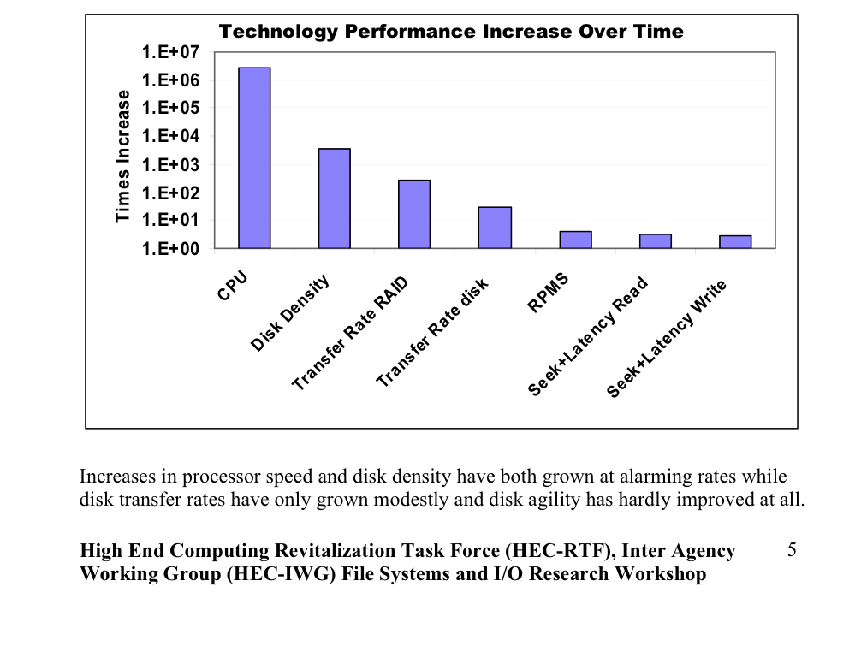
Motivation for the VDC Computing technology performance increases from 1977 to 2006
Moore’s Law does not apply to these!!!
Orders of magnitude difference between improvements in CPU speed and IO bandwidth
Balance between compute and IO is changing rapidly
Notes:
Technologies advance at different rates - not all follow Moore’s law
Particularly critical for interactive data analysis applications is the disparity between compute and IO. Most typically viz applications are IO bound.
Interestingly, GPU technology is and has been for several years, on a faster curve than CPU technology

Slide 4
Limitations to data analysis and visualization
Due to recent trends in computing technology that are expected to continue for the foreseeable future, data analysis and visualization are often constrained by:
The rate at which data can be read from disk (I/O bandwidth)
The capacity of available random access secondary storage (i.e. disk space)

Slide 5
The VAPOR Data Collection (VDC) Interact with Terabytes of data using only a commodity computer
Progressive data access
Permit speed/quality tradeoffs
Region of Interest (ROI) identification and isolation
Two wavelet-based models:
VDC Type 1: multiresolution
VDC Type 2: multiresolution and coefficient prioritization
GoogleEarth model
Visual data
browsing
Combination of visualization, ROI isolation, and multiresolution data representation that provides sufficient data reduction to enable interactive work
Refine
Coarsen
Quantitative
analysis
Data
manipulation
Think Google Earth!!!
Notes:
Combination of visualization and multiresolution data representation provide sufficient data reduction to enable interactive work
Domain specific focus

Slide 6
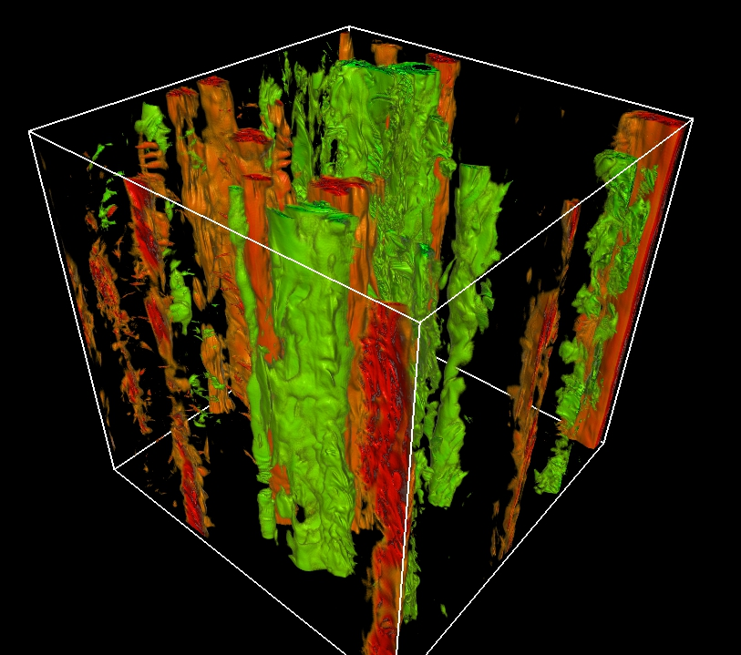
ABC Turbulence live demo
1536^3 computation grid
12GBs/variable/time-step
100’s of time steps saved
Terabytes of data in aggregate!
Mininni and Pouquet, 2010

Slide 7
Intro to Wavelets and Compression
Many popular multi-media formats employ wavelet based compression techniques
E.g. JPEG 2000 (still images), Ogg (A/V), Dirac (video)
Extending wavelet techniques to multi-dimensional, gridded scientific data is relatively straight forward
Advantages of Wavelet based compression strategies for scientific data include:
Reduced storage capacity
Reduced IO bandwidth
Reduced computation and memory needs
Wavelet based compression readily supports hierarchical data representation
Coarsened approximations in hierarchy have fewer grid points leading to less processing and less memory
Progressive refinement
Data may be delivered with progressively increasing detail, providing coarse approximations that may be selectively refined all the way up to the original data

Slide 8
Wavelet transforms in a nutshell
Similar to Fourier transforms a Wavelet transform expresses a signal f(t) as linear expansion :
where a_{l} are real-valued coefficients, and ψ_{l} are basis functions
For many wavelet functions the transform coefficients, a_{l} , are simply given by the inner product:
Wavelet transforms have several key differences from Fourier transforms
Basis function, ψ, is a wavelet, not a complex exponential
Wavelets have compact support (zero value outside of a narrow interval)
transforms can localize signal details (frequencies) in time (space). This tells us not just what frequencies are present but when (where) they occur
Forward and inverse transforms are computationally efficient: O(N) compared to O(N*logN) for Fourier

Slide 9
Discrete Wavelet Transforms
The wavelet basis function is constructed from a scaling function, ϕ:
which is recursively constructed from scaled, dyadic translates of itself:
which leads to a more general representation of a wavelet expansion of f:
Scaling term: low resolution approximation of f(t)
Detail term: high frequency components of signal missing from scaling term

Slide 10
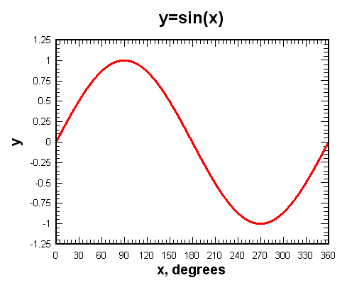
A very small sampling of wavelet basis functions
Fourier transform basis function: sine, cosine
Compact support of wavelets enables efficient transforms and ability of wavelet transforms to isolate signal components in time (space)
Image credit: K.H. Parker

Slide 11
Wavelet compression and progressive access (1) Frequency truncation method
Truncate “j” parameter in expansion:
Provides coarsened approximation of signal at power-of-two increments
Good
Simple to implement
Extremely computationally efficient (much faster than reading data)
Retained coefficients are implicitly addressed => no additional storage required
Progressive refinement readily provided
Perfect reconstruction
Not so good:
Limited to power-of-two grid reductions
Quality of approximations

Slide 12
Wavelet compression and progressive access (2) Coefficient prioritization method
Goal: prioritize coefficients used in linear expansion based on contribution to signal
L² error given by:
If u(t) are orthonormal, then:
The L² error is the sum of the squares of the coefficients we leave out!
So to minimize the L² error, we simply discard (or delay transfer) the smallest coefficients!
If discarded coefficients are zero, there is no information loss!

Slide 13
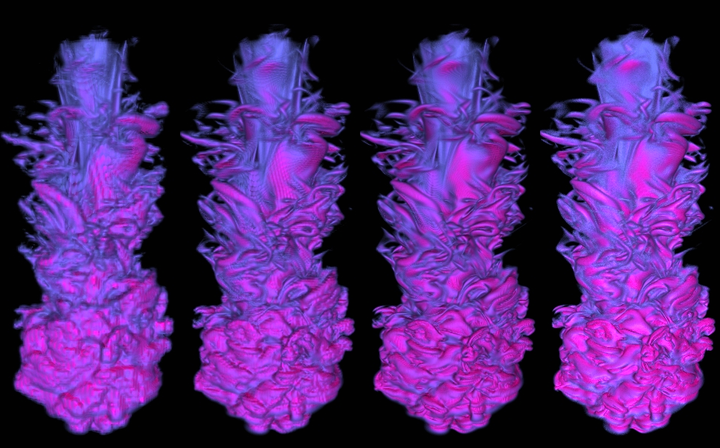
A simulated solar thermal plume at varying grid resolutions provided Compression: Frequency Truncation
What have we lost???
63²x256
reduction: (512:1)
126²x512
(64:1)
252²x1024
(8:1)
504²x2048
(native)

Slide 14
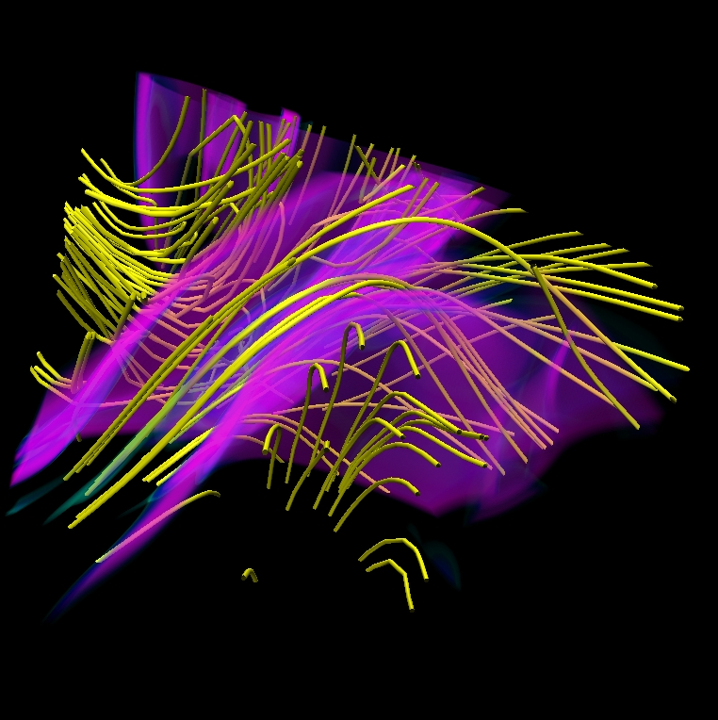
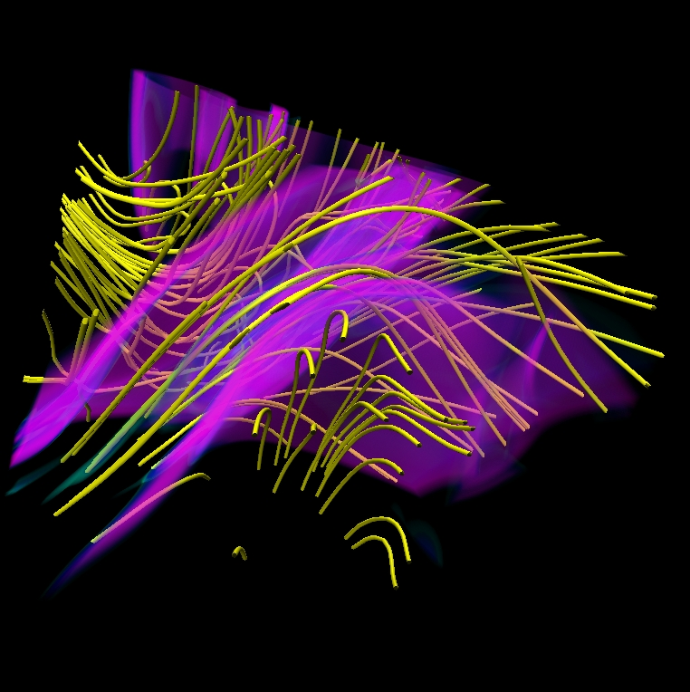
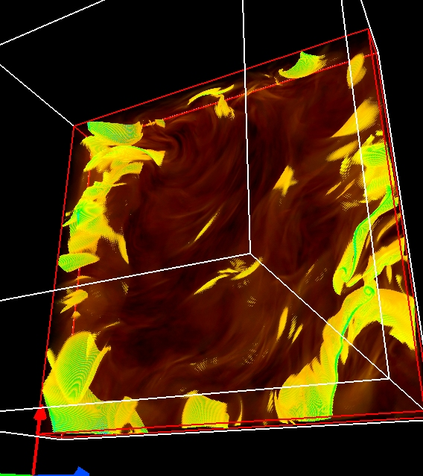
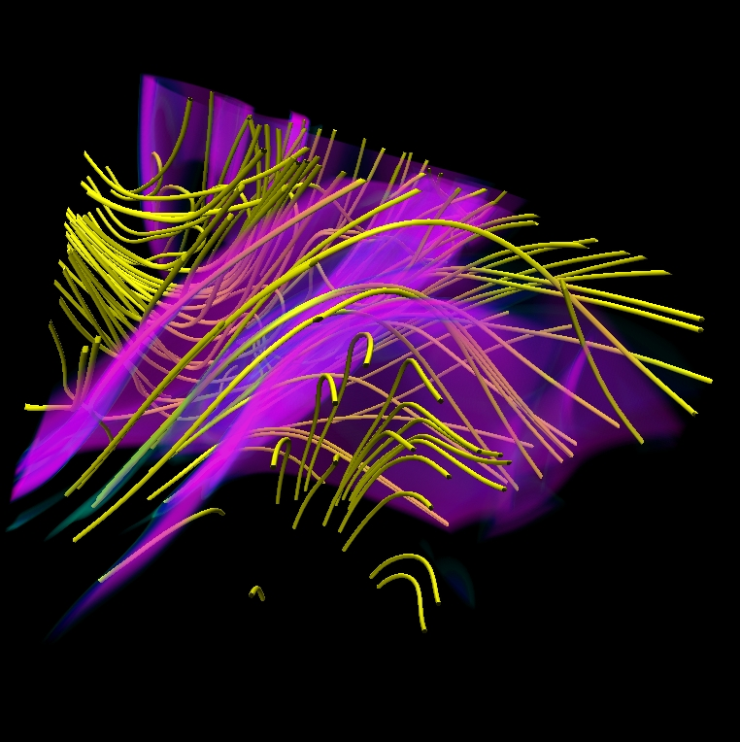
Integration of magnetic field lines Compression: frequency truncation
1536³ MHD Simulation
4th order Runge-Kutte
Mininni et al. (2007)
192³
384³
768³
1536³

Slide 15
Frequency vs coefficient prioritization 64:1 Compression
Frequency truncation
No compression
Coefficient prioritization
1024³ Taylor-Green turbulence (enstrophy field) [P. Mininni, 2006]

Slide 16
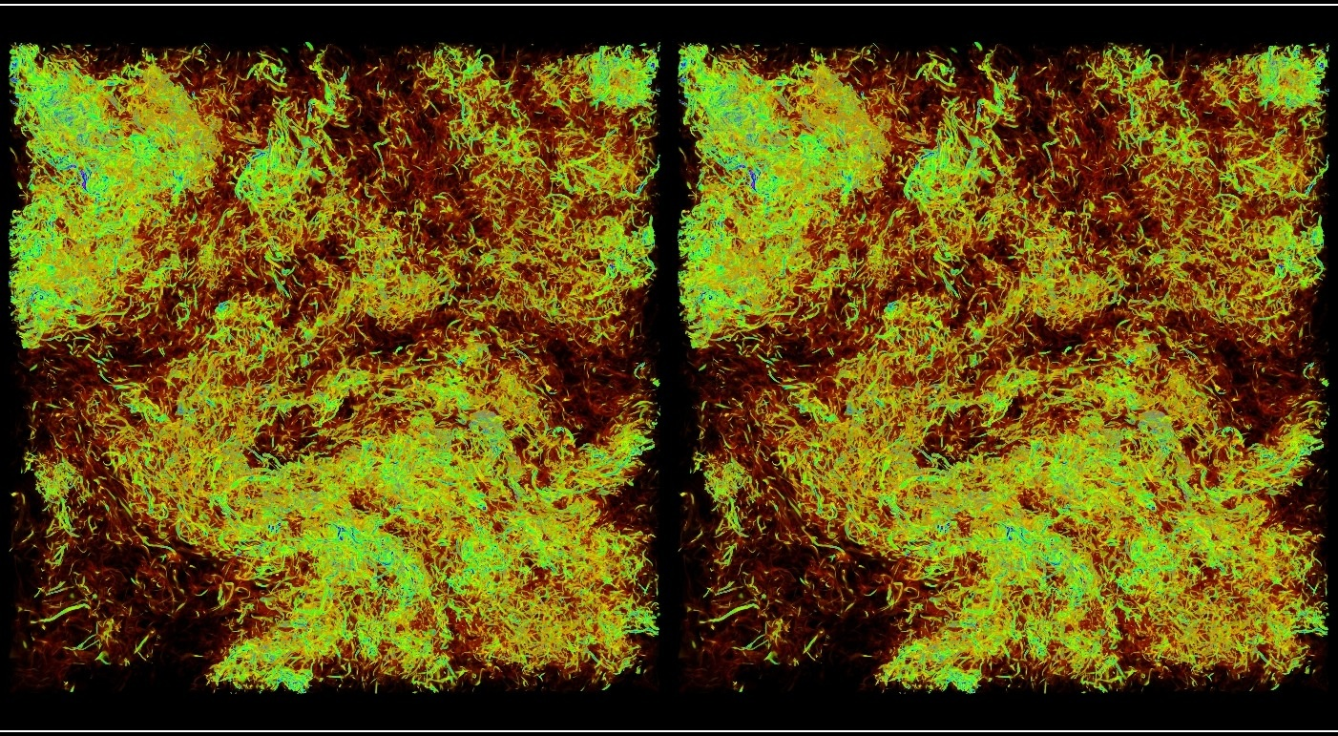
4096³ Homogenous turbulence simulation Volume rendering of original enstrophy field and 800:1 compressed field
Original: 275GBs/field
800:1 compressed: 0.34GBs/field
Data provided by P.K. Yeung at Georgia Tech and Diego Donzis at Texas A&M

Slide 17
VAPOR Data Collection (type 2)
Supports progressive data access based on wavelets
Two types of refinement (quality) control:
refinement level (frequency truncation)
level-of-detail (coefficient prioritization)
Both refinement level (ref) and level-of-detail (lod) effect data approximation quality. But…
ref: determines the number of grid points used in an approximation
impacts memory (RAM) and compute requirements
lod: determines the number of wavelet coefficients read from the VDC
only impacts storage requirements, and consequently I/O bandwidth

Slide 18
ABC Turbulence live demo (revisited)
Type 2 VDC contains:
1536^3 grid
one variable (vx)
4 ``lods’’
500:1 (43 MB)
100:1 (173 MB)
10:1 (1.9 GB)
1:1 (12 GB)
4 ``refs’’ grids
0 (192^3 grid points)
1 (384^3)
2 (768^3)
3 (1536^3)
Mininni and Pouquet, 2010

Slide 19
Anatomy of a VAPOR Data Collection (VDC)
Two components to a VDC:
An XML metadata file describing global properties of the data
A directory containing wavelet coefficients for each variable and timestep
mydata.vdf
mydata_data
Global metadata:
Variable names
Grid resolution
# time steps
Domain extents
…
U
V
W
Temp
Variable names
U.000.nc0
U.000.nc1
U.000.nc2
U.001.nc0
U.001.nc1
U.001.nc2
U.nnn.nc0
U.nnn.nc1
U.nnn.nc2
Wavelet
coefficients
time step
level of detail (VDC2)
refinement level (VDC1)
A VDC does not have to be complete to be valid. Missing variables, time steps, and even levels-of-detail are allowed

Slide 20
Grid dimensions
compression ratios (lod)
Domain extents
3D Variable names
File paths to wavelet coefficients

Slide 21
Recursive directory list of ABC data in VDC form “ls –l ABC05*”
Size in bytes
Levels of detail

Slide 22
Translating data into a VDC
Two step process
Generate a .vdf XML metadata file describing data
Populate VDC with wavelet coefficients
Only include those time steps or variables immediately needed
Generating .vdf file:
Command line tools and programming interfaces for .vdf generation
Recommended: use appropriate command line utility
vdfcreate: general purpose utility
wrfvdfcreate, flashvdfcreate, momvdfcreate, etc. : produce .vdf from WRF, FLASH, MOM, etc. data
Populating VDC
Command line utilities
IDL language bindings
C++ API
Parallel Fortran API

Slide 23
Creating a .vdf file with vdfcreate
Use vdfcreate when a model-specific utility (e.g.wrfvdfcreate) doesn’t exist for your data
Minimum recommended options for a usable .vdf file:
-dimension <NXxNYxNZ>
Defines data volume dimensions in grid points for all gridded data in the VDC
The fastest varying dimension is NX, the second fastest is NY, etc.

Slide 24
Other common vdfcreate command line options you’ll probably want to include
-vars3d <var1[:var2]*>
Colon delimited list of names of all 3D variables
-numts <ts>
Number of discrete time steps that will be included in VDC
It’s OK to overestimate
-vdc2
Generates a Type 2 VDC collection (coefficient prioritization)
-extents <x0:y0:z0:x1:y1:z1>
Coordinates of grid extents in your user-defined coordinate system. (x0,y0,z0) give coordinate of first grid point. (x1,y1,z1) give coordinate of last grid point
-startt <time>
Time, in user-defined coordinate system, of first time step in VDC
-deltat <time>
Time, in user-defined coordinates, between successive time steps
Needed for accurate flow integration

Slide 25
vdfcreate examples
vdfcreate –dim 256x512x512 mydata1.vdf
Creates a .vdf for a VDC containing a single variable (named “var1”), at a single time step, on a 256x512^3 grid
The user spatial extents will default to (0.0, 0.0, 0.0), (0.5, 1.0, 1.0)
vdfcreate –vars3d U:V:W –vdc2dxy height –numts 10 –extents 0:0:0:100:200:200 –dim 256x512x512 mydata2.vdf
Creates a .vdf for a VDC containing three 3D variables (named “U”, “V”, and “W”), and one 2D variable (“height”), and up to 10 time steps
The user spatial extents will be set to (0.0, 0.0, 0.0), (100.0, 200.0, 200.0)

Slide 26
Populating a VDC with raw2vdf
raw2vdf translates file containing a “block of floats” into a VDC
A “block of floats” is a memory image of a 3D (or 2D) array of floating point values.
The file must contain a contiguous array of data with no leading header.
only one variable, at one time step per file
=> size of file in bytes must be the grid dimension times the size of a float (4)

Slide 27
raw2vdf examples
raw2vdf –var U –ts 0 mydata2.vdf u.raw
Assuming we’re using the mydata2.vdf file created with previous example
Performs a wavelet transformation on the file u.raw, which must contain an array of floats of dimension 256x512^2
The resulting wavelet coefficients are stored in the VDC at time step 0, for the variable named “U”

Slide 28
Creating a .vdf file when a model-specific command line utility is available
For some numerical models commonly used in the geo-sciences, model-specific conversion tools exist
VAPOR currently provides conversion tools for:
Weather Research Forecast model (WRF)
FLASH – a multi-physics, multi-scale code
and in release 2.2 we will support:
Parallel Ocean Program (POP)
Modular Ocean Model (MOM4)
Regional Ocean Modeling System (ROMS)
When a model-specific translator exists it should always be used!

Slide 29
Creating a .vdf file with wrfvdfcreate
If your data set was output by WRF, use the wrfvdfcreate command to generate a .vdf file.
Unlike the general purpose vdfcreate command, wrfvdfcreate reads the WRF output files to derive the information it needs to generate a correct .vdf file
Hence, rarely are any command line options needed. Command line options you may consider:
-vdc2 : generate a VDC Type 2 data set (default is Type 1)
General form of command:
wrfvdfcreate wrf_file1 wrf_file2 … wrf_fileN mydata.vdf
Inputs
Output

Slide 30
wrfvdfcreate example with jangmi data

Slide 31
Creating a .vdf file with romsvdfcreate, momvdfcreate, popvdfcreate
These utilities will be available starting with release 2.2 of VAPOR
Invocation and options are almost identical to wrf2vdf, with the following exceptions:
Time-invariant information is provided in a separate MOM/POP/ROMS output file
The default VDC type is 2, so –vdc2 is not needed
General form of commands:
*vdfcreate time_invariant_file file1 file2 … fileN mydata.vdf
where “*” is one of mom, pop, or roms

Slide 32
examples
wrfvdfcreate wrfout1 wrfout2 mydata.vdf
Creates a .vdf for a VDC suitable for containing all of the 2D and 3D time-varying variables, at all time steps, in the netCDF files wrfout1 and wrfout2.
romsvdfcreate grid_file romsout1 romsout2 mydata.vdf
Creates a .vdf for a VDC suitable for containing all of the 2D and 3D time-varying variables, at all time steps, in the netCDF files romsout1 and romsout2.

Slide 33
Populating a VDC with a model-specific command
Much simpler than using raw2vdf
The contents of the model output files combined with a.vdf file provide most of the information needed for conversion
Commonly used command line options:
-varnames : specifies list of variables to convert (default is all variables found)
-lod : limits the saved levels-of-detail for VDC Type 2(default is all)
-level : limits the saved refinement levels for VDC Type1 (default is all)
General form of commands:
wrf2vdf wrffile1 wrffile2 … wrffileN mydata.vdf
*2vdf time_invariant_file file1 file2 … fileN mydata.vdf
where “*” is one of mom, pop, or roms

Slide 34
Examples
wrf2vdf mydata.vdf wrfout1 wrfout2
Populates the VDC associated with mydata.vdf with all of the variables and time steps found in the WRF netCDF files wrfout1 and wrfout2
wrf2vdf –varnames U:V:W mydata.vdf wrfout1 wrfout2
Populates the VDC associated with mydata.vdf with the variables named “U”, “V”,and “W” at all time steps found in the WRF netCDF files wrfout1 and wrfout2

Slide 35
Tips for saving storage space
An unfortunate aspect of using a VDC is having two copies of your data.
A VDC may be incomplete in the sense that any of the following may be missing:
Time steps
Variables
Refinement or level-of-detail levels
Use the appropriate *2vdf command line options to limit contents of VDC to only what you need:
-numts : Limits the number of time steps converted
-level : (Type 1 VDC) limits refinement levels output
-lod: (Type 2 VDC) limits levels-of-detail output
-varnames : limits the variables output

Slide 36
Frequently Asked Questions (FAQs)
How long will it take to convert my data to a VDC?
The wavelet transformation is very fast and has been parallelized to take advantage of multi-core processors. Typically it takes about twice as long to translate a file as it takes to copy it from one place on disk to another.
Pruning variables and/or time steps will save time and space
How much space overhead is there for a VDC
Internally data are decomposed into blocks: 64^3 (32^3 for VDC1) by default.
If your data are block aligned the overhead is typically less than 1 or 2%.
If your data do not align with block boundaries the overhead will depend on how much padding must be performed.
Can I reconstruct my data from a VDC exactly?
While the wavelet transforms used exhibit “perfect reconstruction”, in reality you can expect differences due to floating point round off.

Slide 37
Example data sets (This slide is NOT in your handouts. Apologies!)
Data used from the tutorial are available from:
ftp://ftp.ucar.edu/vapor/data/jangmi_lowres.zip
ftp://ftp.ucar.edu/vapor/data/jangmiWrfout1.zip
ftp://ftp.ucar.edu/vapor/data/jangmiWrfout2.zip
Other data sets available from:
https://www.vapor.ucar.edu/page/vapor-download#Example
Updated tutorial slides (and other tutorials):
https://www.vapor.ucar.edu/docs/vapor-tutorials

Slide 38
Questions???
www.vapor.ucar.edu
vapor@ucar.edu

