Slide 1
An Introduction to VAPOR A KISTI & NCAR collaborative research agreement
John Clyne, Alan Norton
National Center for Atmospheric Research
Boulder, CO USA
Korean Supercomputing Conference
Oct 6, 2014
This work is funded in part through U.S. National Science Foundation grants 03-25934 and 09-06379, 14-40412, and through a TeraGrid GIG award, and with support from the Korean Institute for Science and Technology Information (KISTI)
Notes:
Provide enough information so that you know what the tool is capable of

Slide 2
The VAPOR project
The work presented here is part of an on-going research partnership between the Korean Institute of Science and Information Technology (KISTI) and the U.S. National Center for Atmospheric Research (NCAR)
Goal: extend VAPOR visualization package to better support geoscience numerical simulation communities
Currently we are in year four of the NCAR/KISTI collaboration

Slide 3
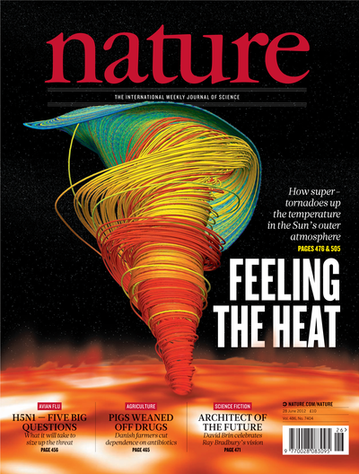
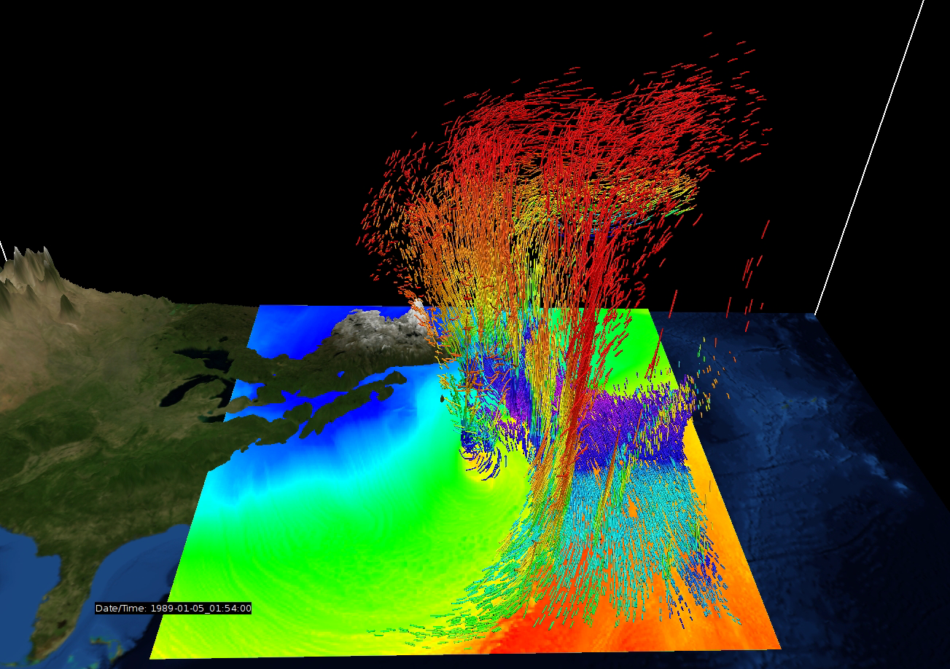
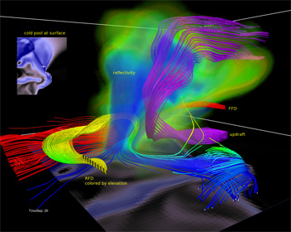
VAPOR Visualization aided data analysis for the earth sciences
A domain-focused, open source visual data analysis package targeted for researchers in the atmospheric, oceanic, and related sciences
By leveraging a wavelet-based intelligent data storage model VAPOR enables highly interactive exploration of the largest numerical simulation outputs using only commodity computing resources.
A community-driven feature set guided by an international steering committee of computational scientists working in a broad gamut of earth science disciplines
Metrics:
~6000 new users since January, 2011
~4000 unique VAPOR web site visitors per month in 2013 (up from 1000 in 2012, and 500 in 2011)
~100 scholarly citations for VAPOR
I. Grooms, et al. 2010
www.vapor.ucar.edu
S. Wedemeyer-Böhm, et al. 2012
VAPOR is funded in part through U.S. National Science Foundation grants 03-25934 and 09-06379, a TeraGrid GIG award, and the Korean Institute for Science and Information Technology
M. Shapiro; S. Grønås, 2012
L. Orf, 2009
Notes:
Re user metrics: prior to 2011 registration was not required
Shapiro figure: Simulation of the 1989 extratropical cyclone ERICA IOP 4, the most intense winter cyclone ever measured in the central Atlantic.
Orf figure: A snapshot in time of a numerically simulated supercell thunderstorm conducted by Associate Professor Leigh Orf at Central Michigan University. This cover visualization appears on the 2009 Coalition for Academic Scientific Computation (CASC) brocure.
Wedemever-Bohm figure: The cover of the June 28 issue of Nature, produced by a team a the U. of Oslo, Norway. Magnetic tornadoes resemble tornadoes on the Earth but have a magnetic skeleton and are hundreds to thousands times larger in diameter. One such observed tornado occupies the area equivalent of Europe or the USA.
Grooms figure: The cover of Physical Review Letters (volume 104, num. 22, 2010), An image of convective Taylor columns in rotating Rayleigh-Benard convection produced by a team at the U. of Colorado.

Slide 4
Who are the VAPOR users?
Notes:
Combination of visualization and multiresolution data representation provide sufficient data reduction to enable interactive work
Domain specific focus

Slide 5
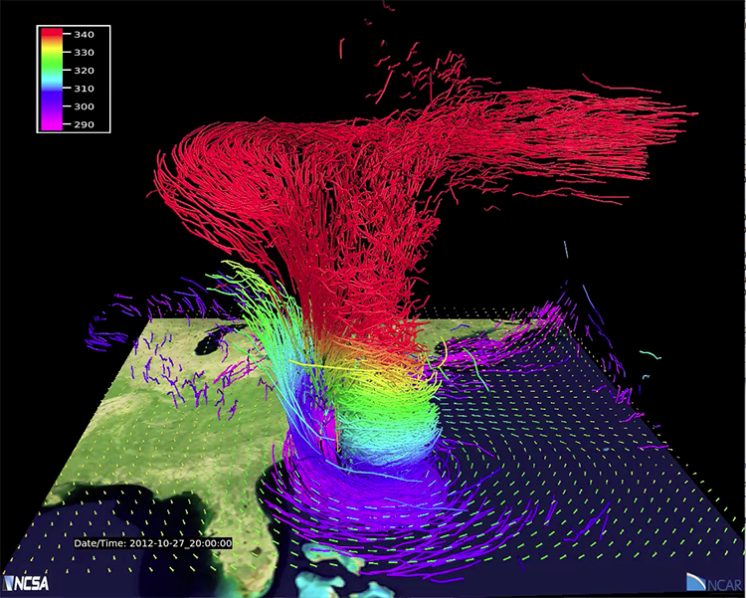
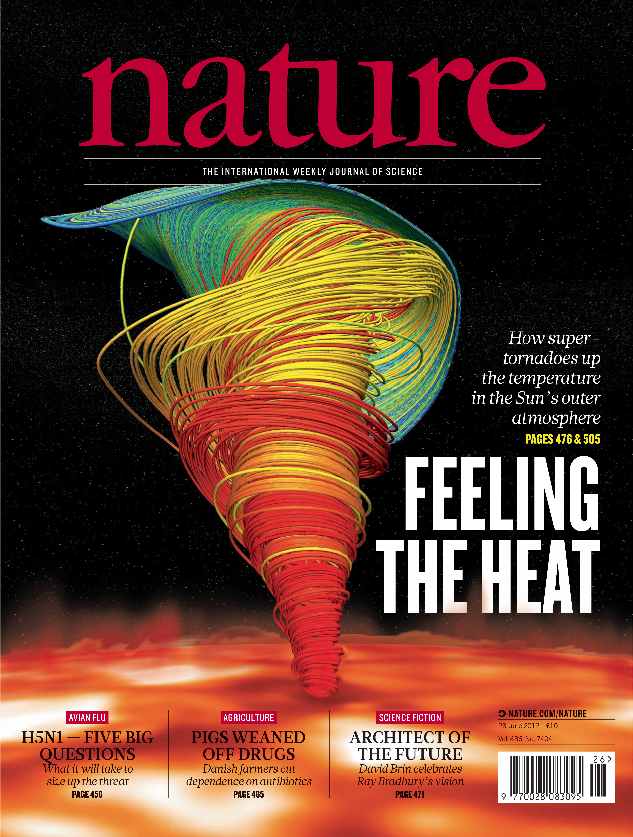
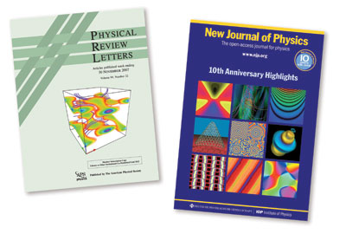
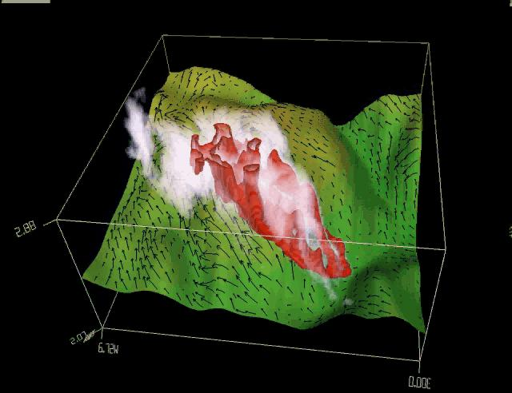
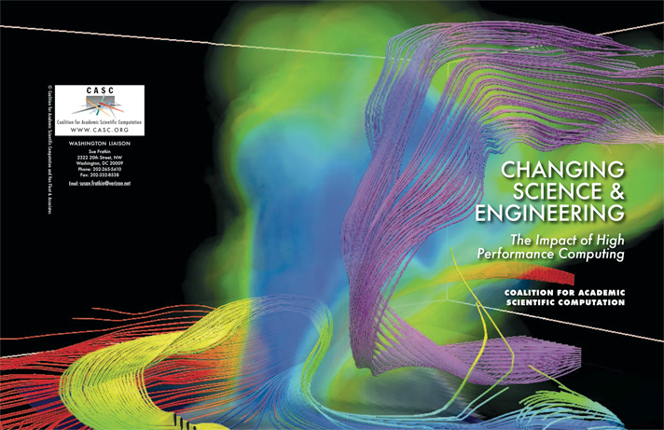
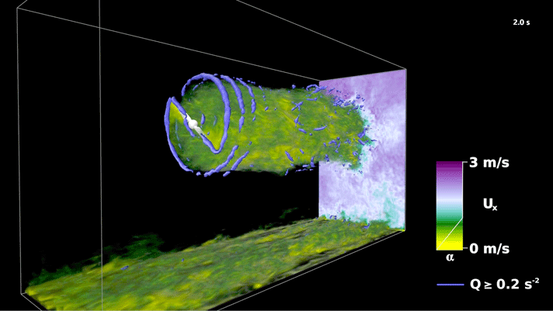
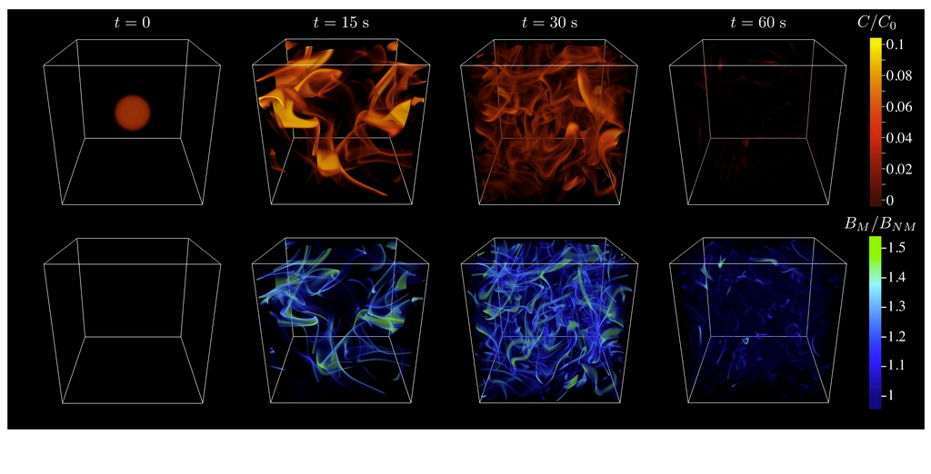
A sampling of scientific domains using VAPOR
Numerical Weather Prediction
Mel Shapiro, NCAR
Solar
Sven Wedemeyer-Böhm
U. of Oslo
Computational Fluid
Dynamics
Wild Fires
Janice Coen, NCAR
Marine Biology
John Taylor, U. of Cambridge
Severe Weather
Leigh Orf, U. Central Michigan
Energy
Kenny Gruchalla, NREL

Slide 6
Key Components: What makes VAPOR different from other visualization tools?
Domain specific: earth and space sciences CFD
Data analysis: qualitative and quantitative data interrogation and manipulation capabilities
Terabytes from the desktop: operates on terascale sized simulations with only desktop computing
Notes:
Combination of visualization and multiresolution data representation provide sufficient data reduction to enable interactive work
Domain specific focus

Slide 7
Key Components: What makes VAPOR different from other visualization tools?
Domain specific: earth and space sciences CFD
Data analysis: qualitative and quantitative data interrogation and manipulation capabilities
Terabytes from the desktop: operates on terascale sized simulations with only desktop computing
Notes:
Combination of visualization and multiresolution data representation provide sufficient data reduction to enable interactive work
Domain specific focus

Slide 8
Key Component (3) Terabyte data handling from a desktop PC (or laptop)
Progressive access data model (VAPOR Data Collection)
Permit speed/quality tradeoffs
Region of Interest (ROI) identification and isolation
Two wavelet-based refinement models:
refinement level (grid coarsening)
level-of-detail (wavelet coefficient prioritization)
Visual data
browsing
Combination of visualization, ROI isolation, and multiresolution data representation that provides sufficient data reduction to enable interactive work
Refine
Coarsen
Quantitative
analysis
Data
manipulation
Think Google Earth!!!
Notes:
Combination of visualization and multiresolution data representation provide sufficient data reduction to enable interactive work
Domain specific focus

Slide 9
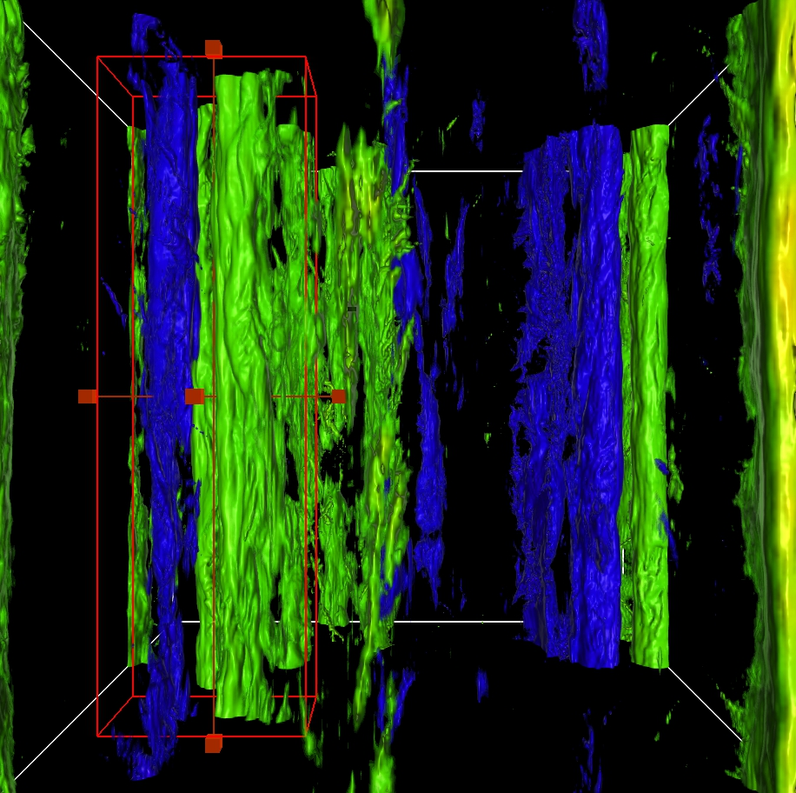
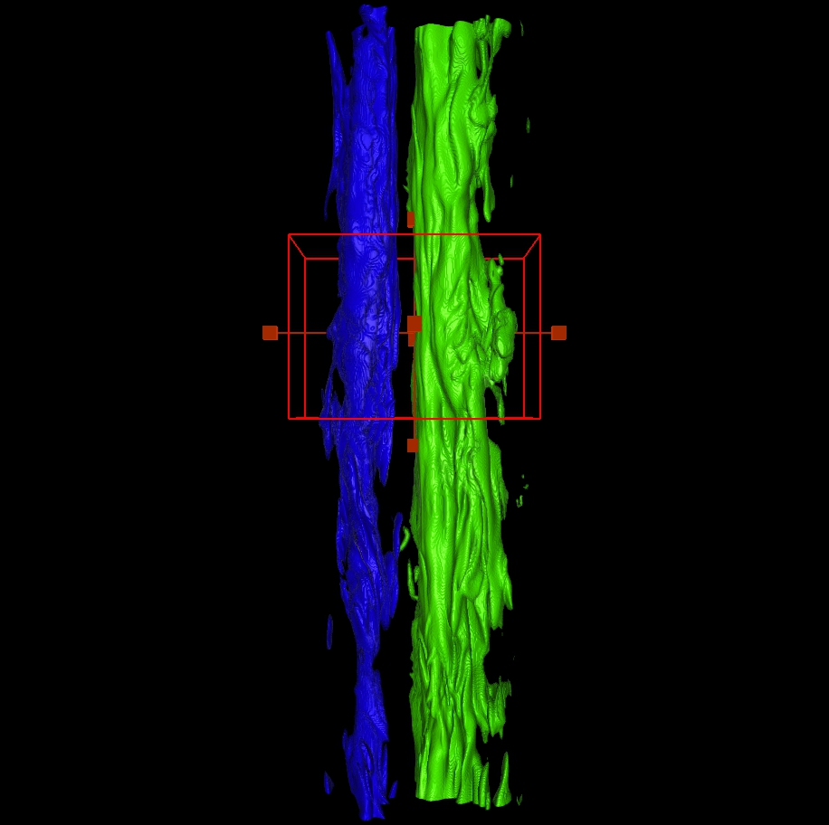
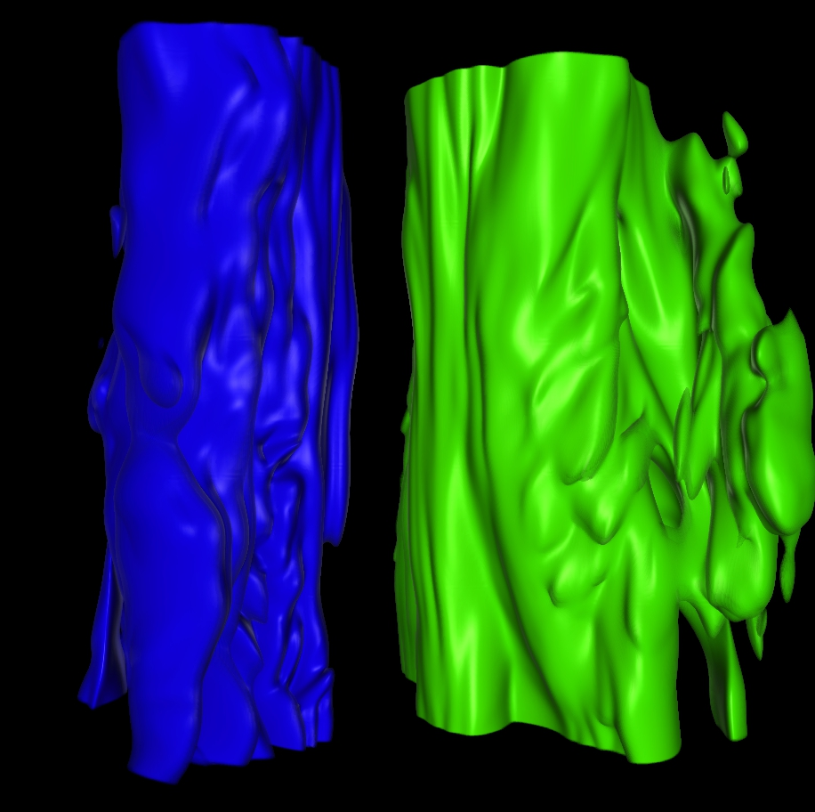
Wavelet Enabled Progressive Data Refinement Exploring a 1536³ simulation output on a laptop
Browse highly compressed data, subset, refine, repeat.
Full domain, compressed 500:1
14GBs -> 29MBs
Region of interest (ROI), 100:1
800MBs -> 8MBs
ROI, No compression
182MBs

Slide 10
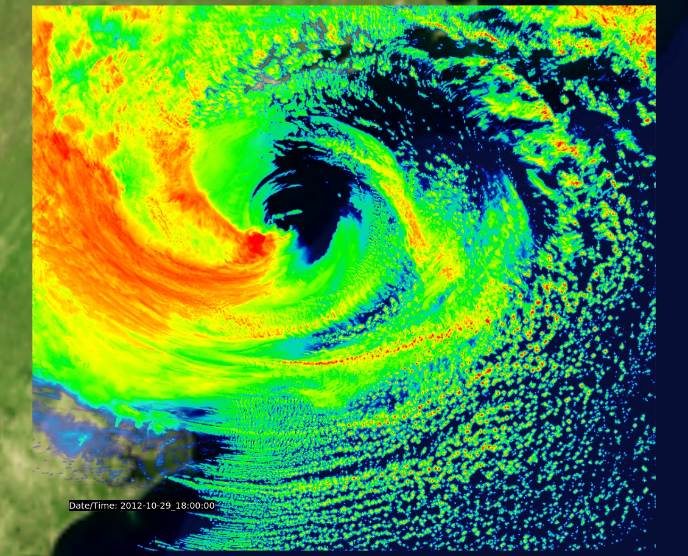
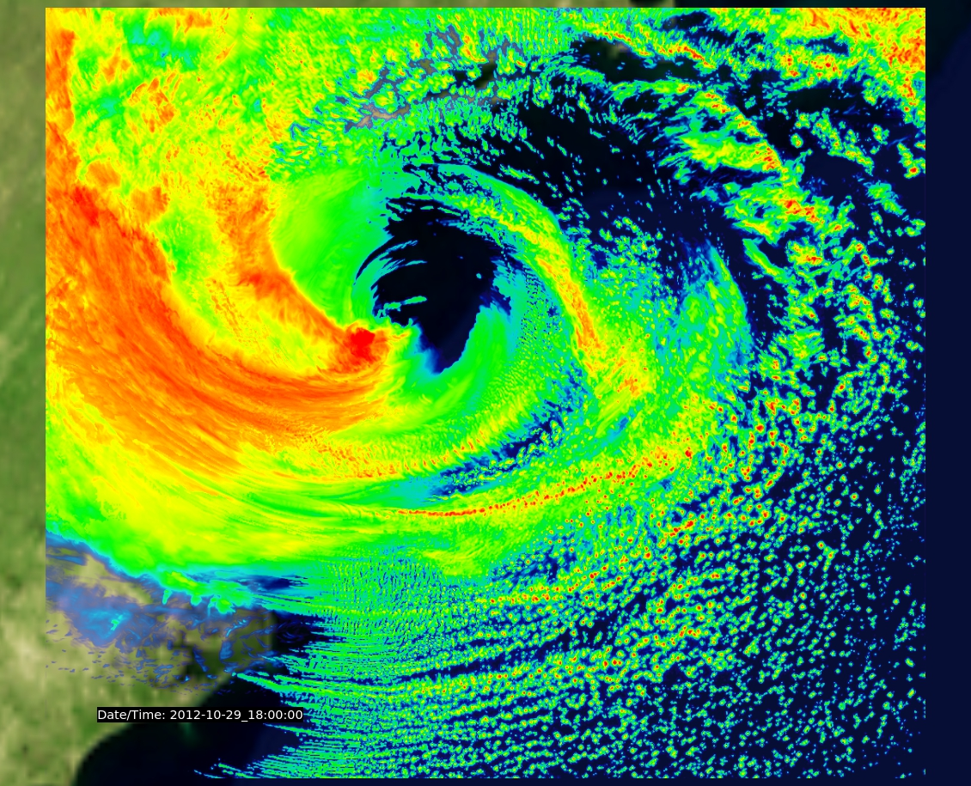
Radar reflectivity derived from a 500m Weather Research Forecast simulation of Hurricane Sandy, the largest NWP model ever run [Johnsen 2013]
DBZ computed from original data (203 GBs)
DBZ computed from variables compressed
10:1 (20.3 GBs)

Slide 11
Hurricane Sandy simulation visualized with VAPOR
Largest severe storm simulation to date
9120x9216x152 grid points
0.5KM resolution
48GBs/variable/time step
100TBs total data

Slide 12
Supported file formats & model outputs
Climate Forecast (CF) convention NetCDF files
MOM4
POP
ROMS
CAM
WRF outputs
NetCDF (structured grid data)
Flash AMR
Raw (binary) data
GRIB1 and GRIB2 (in version 2.4)
Features
GPU enabled volume rendering and isosurfaces
Cutting planes
Isolines (in version 2.4)
Flow visualization
Streamlines (steady flows)
Pathlines (unsteady flows)
Image Based Flow Vis.
Hedgehog plots (wind barbs)
Geo-referenced data support
NumPy/SciPy calculation engine
Key-frame animation
Quantitative analysis
Probes
Statistics

Slide 13
Questions???
www.vapor.ucar.edu
vapor@ucar.edu

