Slide 1
Understanding Earth Science Data with Interactive 3D Visualization
Alan Norton and John Clyne
NCAR/CISL
Tutorial at Korean Supercomputing
October 12, 2012
This work is funded in part through U.S. National Science Foundation grants 03-25934 and 09-06379, and through a TeraGrid GIG award, and with support from the Korean Institute for Science and Technology Information (KISTI)

Slide 2
Tutorial Overview
Purpose : Demonstrate the use of VAPOR in interactively visualizing and animating earth science data
Utilizing VAPOR (A visualization and analysis package developed at NCAR):
We shall demonstrate many of the useful capabilities of VAPOR, as applied to weather, ocean, and other models
Example data is provided so that you can repeat the visualizations on your own computer, by following the instructions in these PowerPoint slides. Attendees are not expected to perform these visualizations during the tutorial!
Please ask questions whenever you don’t understand what is being shown!
Notes:
Explain the use of two projections.

Slide 3
Tutorial Outline (Intro)
Intro to VAPOR
VAPOR Overview
Requirements
Installation
How to run vapor GUI
Vapor GUI organization
User Help
Data provided with this tutorial
How to obtain georeferenced images

Slide 4
Tutorial Outline: Typhoon Jangmi Exercise
Set up a visualization session in VAPOR using a simulation of Typhoon Jangmi (Sept. 2008)
Apply geo-referenced image to terrain
Volume rendering: Visualize the typhoon progress with QCLOUD
Build a Transfer Function (color/opacity map)
Create derived variables using Python
Visualize Isosurfaces of wind speed
Color isosurface with another variable
Capture an animation sequence

Slide 5
Tutorial Outline: Typhoon Jangmi concluded
Using the vapor_wrf Python module to visualize radar reflectivity
Visualize 2D variables, e.g. 2D radar reflectivity
Barbs: show wind direction
Flow Images: Animate the flow in planar cross-section
Flow integration (wind visualization)
Streamlines: observe how the air flows through the typhoon
Use the Probe to visualize a vertical slice of W
Use the Probe to place flow seed points, based on vertical wind speed

Slide 6
Tutorial Outline: Additional topics
Unsteady flow:
ERICA example video (M. Shapiro)
VAPOR features new in version 2.2:
Animation control of J. Coen’s fire simulation
Visualize MOM data (global and regional examples)
Visualize ROMS example

Slide 7
VAPOR overview
The VAPOR project is intended to address the problem of understanding data that is too big to interactively read or write
VAPOR is the Visualization and Analysis Platform for Oceanic, atmospheric and solar Research
Goal: Enable scientists to interactively analyze and visualize massive datasets resulting from fluid dynamics simulation
Narrow Domain focus: 2D and 3D, gridded, time-varying turbulence datasets, especially earth-science simulation output.
Model-specific support: WRF-ARW; soon: MOM, POP, ROMS
Essential features:
Wavelet data representation for accelerated data access
Exploits GPU for fast rendering
Designed to be used by earth scientists, not visualization engineers.
Available (free) on Mac, Windows, Linux
Notes:
Our ability to compute has outstripped our ability to analyze data – result: not getting full ROI

Slide 8
VAPOR Requirements
Runs on Linux, Windows, Mac workstations
1GB of memory is sufficient (more is better)
Requires a modern graphics card
Recent nVidia and AMD cards work well. Some Intel cards are OK.
May be necessary to update graphics drivers to get full functionality
3-button mouse needed for 3D navigation
Need sufficient disk space to hold the data to be visualized

Slide 9
VAPOR Installation
Download free binary installer (Vapor 2.1) from “Downloads” menu on VAPOR website
http://www.vapor.ucar.edu
VAPOR is available for Linux, Mac, and Windows
Registration is required
You may need Administrative privileges on your computer
Source is usually not needed
Installation instructions for each platform are provided under the “Documentation” menu, including “User Environment Setup” on Mac and Linux.

Slide 10
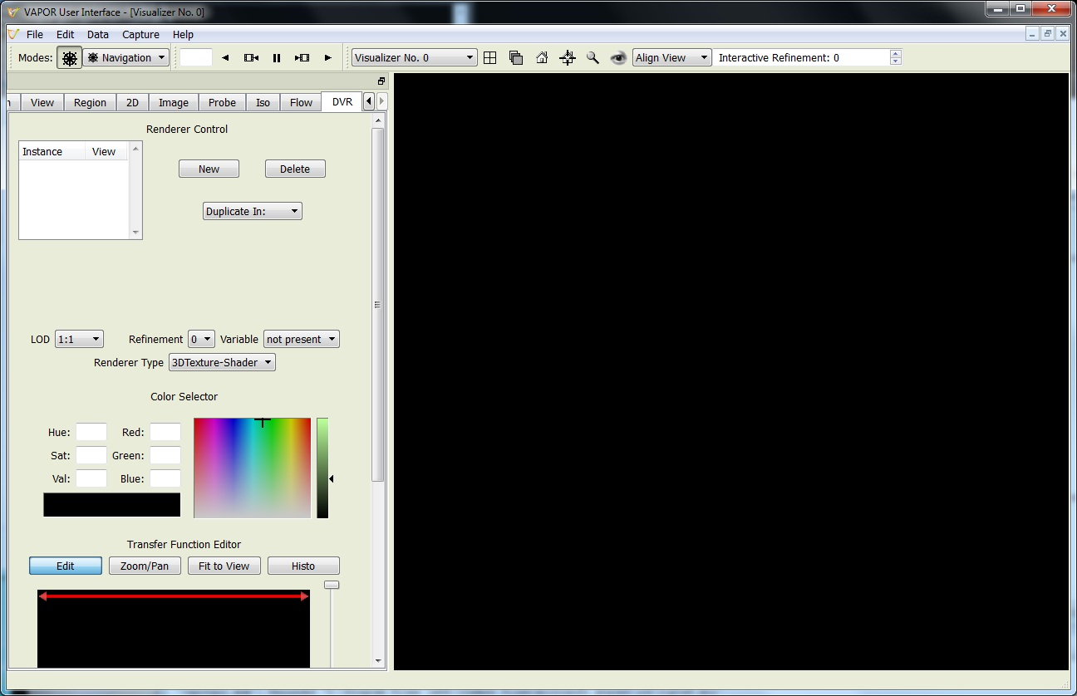
Launching the VAPOR GUI
Click on the VAPOR icon
or from a shell, issue the command “vaporgui”

Slide 11
VAPOR GUI window organization
Menus: File, Edit, Data, Capture, Help
Top: A few commonly used buttons and selectors
Right-hand side: One or more 3D Visualization windows
Left-hand side: Tabs to control visualization and other properties:
DVR, Flow, Iso, Probe, Image, 2D, Region, View, Animation, Model, Barbs
From Edit Menu you can launch:
Visualizer Features Panel
User Preferences Panel
Python Script Editor

Slide 12
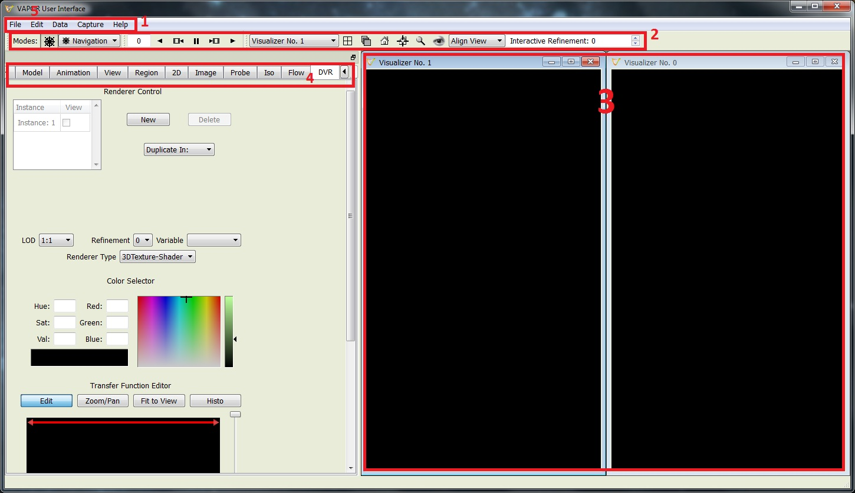
VAPOR GUI features

Slide 13
User help
Tooltips are available for most functions in the tabs: Hold the mouse over the element in the tab
More detailed context-sensitive help: From Help Menu, click “? Explain This”, then click in the GUI.
On the VAPOR Website (http://www.vapor.ucar.edu), click on the “Documentation” menu for explanations of most functions
Several tutorials are available in the “Training” menu on the VAPOR Website
VAPOR Forum is available under the “Support” menu for online discussion.
E-mail us at vapor@ucar.edu for questions or problems

Slide 14
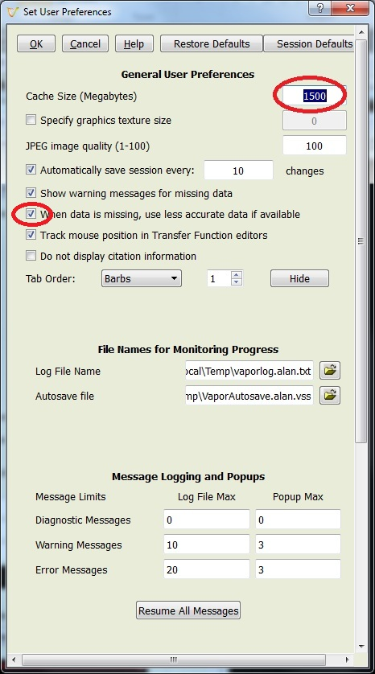
Setup User Preferences
From Edit menu, click “Edit User Preferences”
Set Cache Size (Megabytes) to the amount of memory you expect to have available (e.g. the physical memory on your workstation)
Many other user preferences can be set, e.g. background color, default directories, etc.
Click OK, and save preferences (if you want to have them always set)

Slide 15
WRF Data provided for this tutorial
Low-resolution version of Typhoon Jangmi (will download quickly):
VAPOR dataset in Jangmi_lowres.zip can be downloaded from: ftp://ftp.ucar.edu/vapor/data/jangmi_lowres.zip
jangmi_lowres.vdf VAPOR metadata file
jangmi_lowres_data/ : directory of VAPOR data
Jangmi_terrain.tif : terrain image
Contains everything needed for this tutorial, but at lowered resolution.
Full typhoon Jangmi WRF output files (not necessary):
Download: ftp://ftp.ucar.edu/vapor/data/jangmiWrfout1.zip , ftp://ftp.ucar.edu/vapor/data/jangmiWrfout2.zip
60 wrfout files, will be slow to download
May be used for highest quality visualization
Unzip these to a directory for use with this tutorial
Notes:
Other users will need to install vapor from http://www.vapor.ucar.edu
Data tiff image and python files should be downloaded from http://vis.ucar.edu/~alan/wrf2012/

Slide 16
Obtaining images to use with VAPOR
Geo-referenced satellite images can be retrieved from the Web, and VAPOR will insert them at the correct world coordinates.
VAPOR provides a shell script “getWMSImage.sh” that can be used to retrieve Web Mapping Service images for a specified longitude/latitude rectangle. It is however somewhat intermittent because of instability of the NASA Web Mapping Service.
A geo-tiff terrain image for the typhoon data has been provided in the jangmi_lowres.zip file.
Several useful images are pre-installed with VAPOR, including a world-wide terrain image, and political boundaries of the U.S and the world. Apply these by clicking “Select Installed Image” in the Image panel.

Slide 17
Optional: getWMSImage.sh exercise
getWMSImage.sh will create a geo-referenced tiff file for a specified lon/lat rectangle. Due to recent NASA server limitations it often fails for some rectangles!
Can obtain satellite images, political boundaries, rivers, etc.
Default obtains an image from the NASA “blue marble” earth
Requires Unix environment (Cygwin on PC will do)
For Typhoon Jangmi,
min: lon = 100, lat = 7
max: lon = 148, lat = 40
From a (tcsh or bash) shell (on Windows, Cygwin is needed), issue the command:
getWMSImage.sh –o terrain.tiff 100 7 148 40
Notes:
From Mac, source /Applications/VAPOR.app/Contents/MacOS/vapor-setup.csh

Slide 18
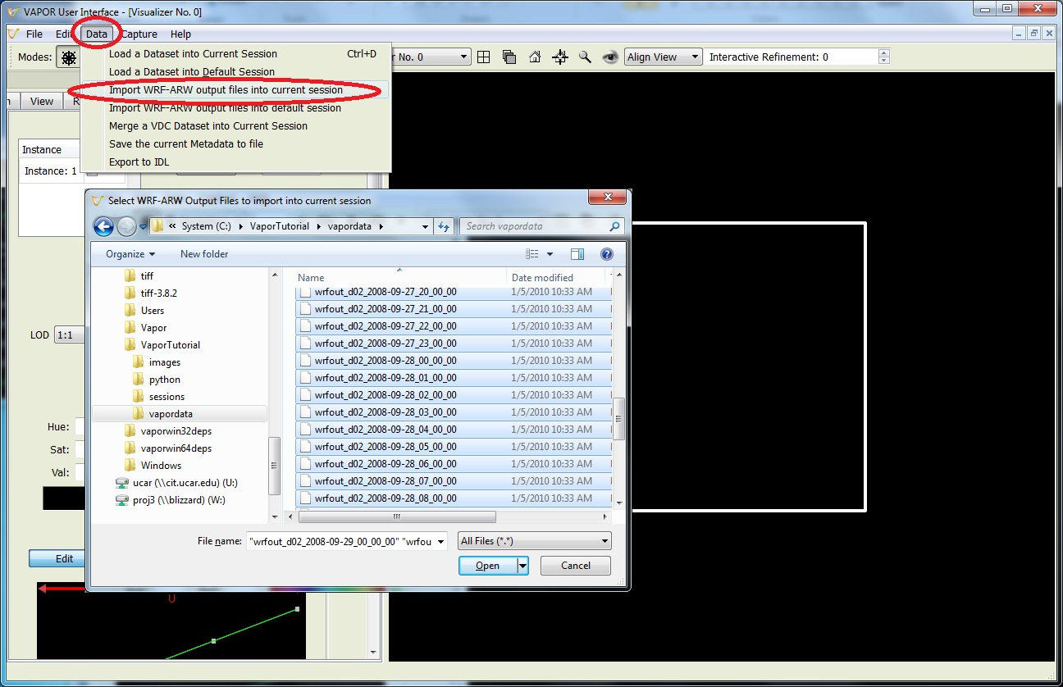
Set-up to visualize a WRF dataset (1)
Launch ‘vaporgui’ (Desktop Icon: )
From Data menu: “Import WRF-ARW output files into current session”: select all (60) jangmi wrfout* files to import

Slide 19
Data reduction needed?
If you did not download the entire set of 60 wrfout files, you can still use a much smaller Vapor Data Collection (VDC) for this tutorial.
The jangmi_lowres.vdf file (and the associated directory jangmi_lowres_data) is a resolution-reduced version of the variables needed for this tutorial.
Instead of using the “Import WRF-ARW files” capability, use “load a dataset into current session” and specify the jangmi_lowres.vdf file.

Slide 20
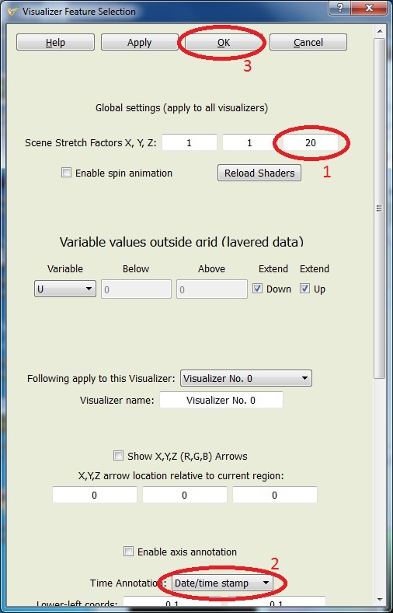
Set-up to visualize a WRF dataset (2)
From Edit menu, click “Edit Visualizer Features” then:
Stretch Z by factor of 20,
press <enter> to confirm value
Specify time annotation, “Date/Time stamp”
Click “OK”
Notes:
Note: 1. Press enter to set a value
Circles on image indicate what students should do.

Slide 21
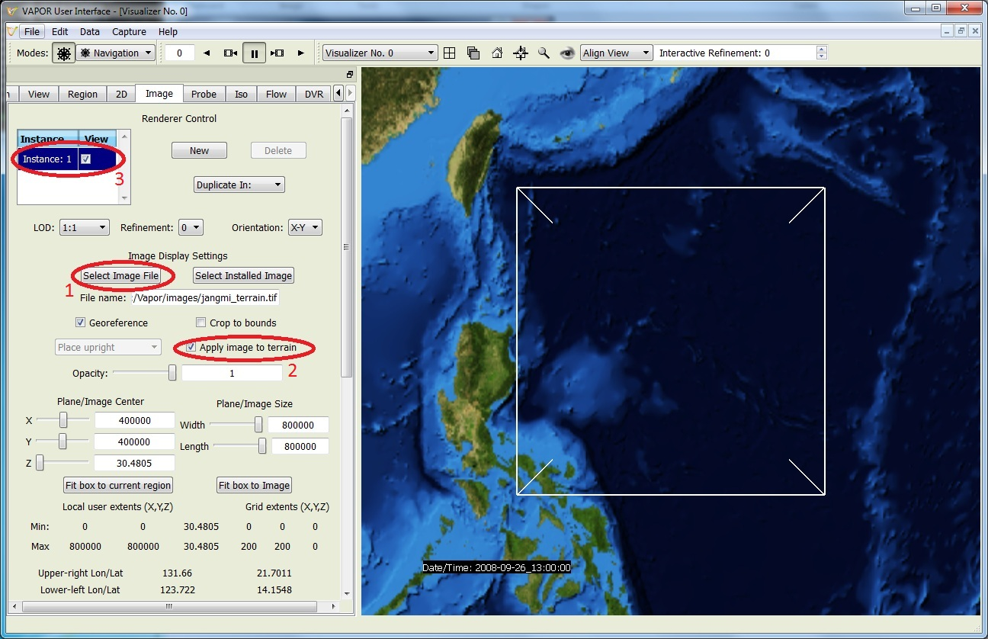
Set-up to visualize a WRF dataset (3)
To include a terrain image: Click on the “Image” tab
Click “Select Image File” and choose
“jangmi_terrain.tif”
Check “Apply image to terrain”
Check the “Instance: 1” checkbox at the top of the Image tab to view the terrain image.
Notes:
Note: on Mac cannot enable “apply to terrain” with jangmi_lowres.vdf
Emphasize red ovals in tab

Slide 22
Ways to Control the 3D Scene
To navigate: Rotate, Zoom in, Translate by dragging in the scene with left, right and middle mouse buttons.
Click “Home” icon ( ) to return to starting viewpoint
Click “Eye” icon ( ) to see full domain
Use Edit→Undo if you make a mistake
Use the VCR controls at the top left of the window to animate through time (see where the WRF d02 domain is positioned over time)
When you type in values, be sure to press <enter> to confirm the values.

Slide 23
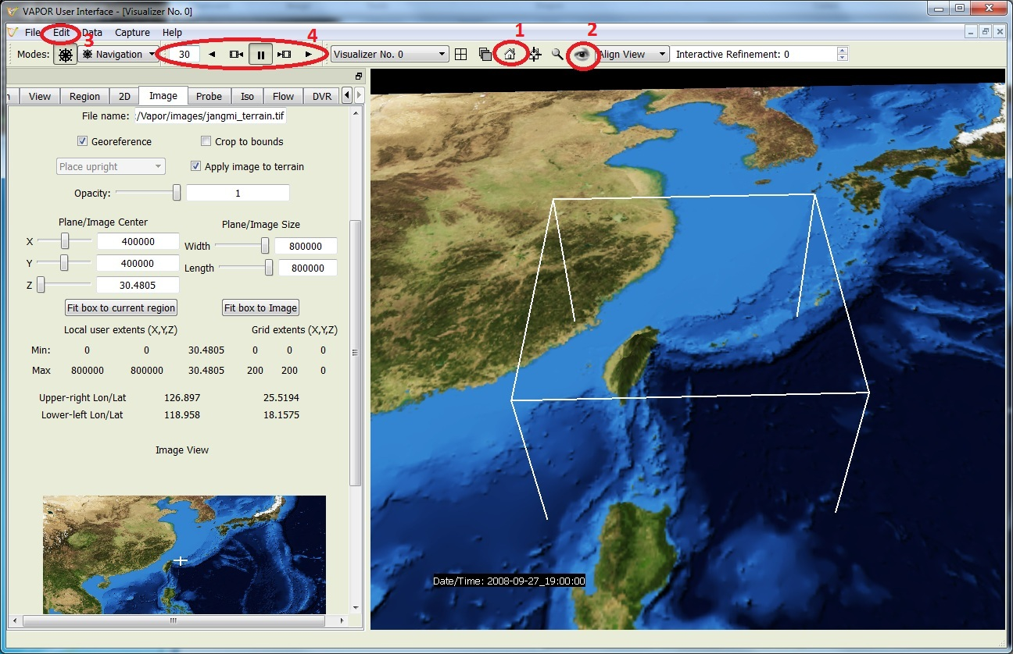
Navigation tools in VAPOR GUI

Slide 24
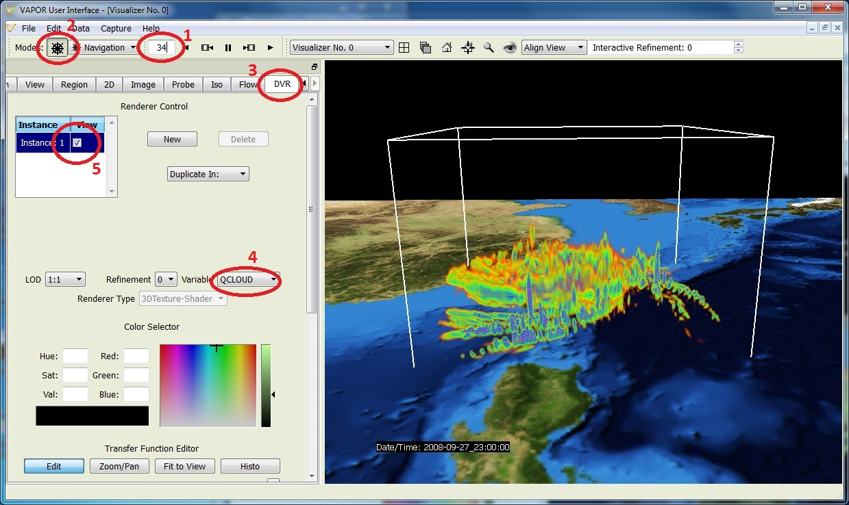
Volume Visualization of QCLOUD
Using VCR control, type in time step 34, press enter.
Click the “wheel” icon ( ) to set navigation mode
Select DVR panel (direct volume rendering)
Select variable “QCLOUD” (cloud water mixing ratio)
Check “Instance:1” to enable volume rendering
Note: May need to click “Fit Data” to get correct bounds on Mac
Notes:
DVR stands for Direct Volume Rendering
Note: Need to click “Fit Data”

Slide 25
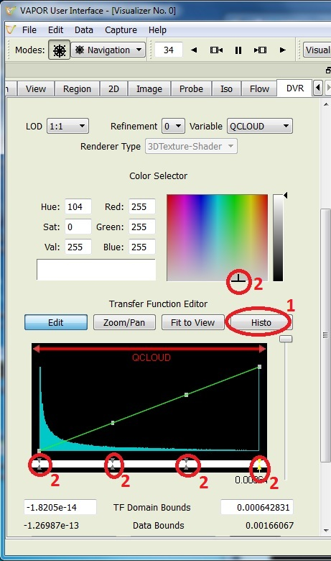
Volume Visualization: Edit Transfer function (1)
Click “Histo” to see histogram of data values of QCLOUD at current timestep
To make the clouds white, set 4 color control points to white
Either select/edit with right mouse button, or
Select point and then choose white color in color selector.
Notes:
slide13.jpg

Slide 26
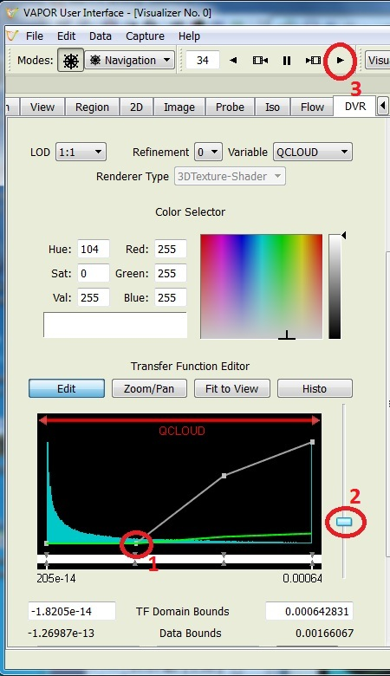
Volume Visualization: Edit Transfer function (2)
To edit the transparency:
Drag the 2nd control point down to make the lower values more transparent
Use slider on the right to control overall transparency.
Click the play button “►” to animate the clouds associated with the typhoon.
Notes:
slide14.jpg

Slide 27
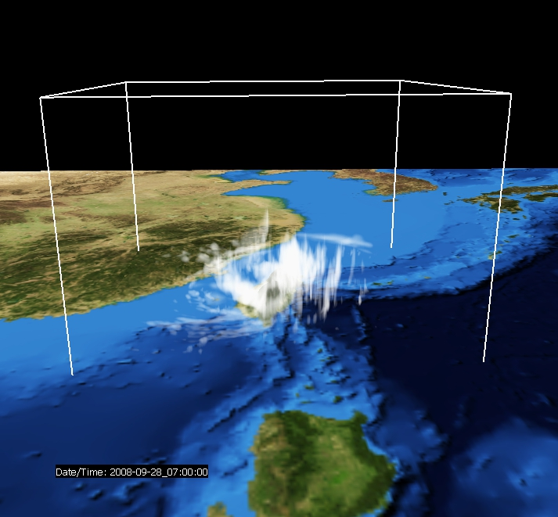
Visualization of typhoon: QCLOUD at time step 42
Notes:
Fig7.vss

Slide 28
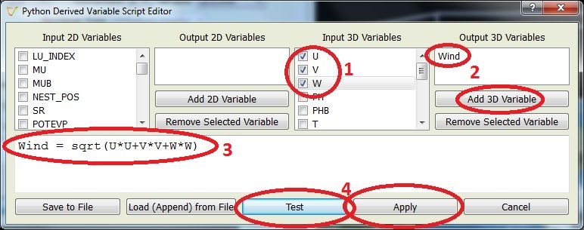
Define derived variable
From VAPOR Edit menu, choose “Edit Python Program defining a new variable”
In the Python editor:
Check U, V, and W as Input 3D Variables.
Add “Wind” as Output 3D Variable.
Type in the one-line python script:
Wind = sqrt(U*U+V*V+W*W)
4. Click “Test”; if response is “Successful Test” it’s OK; then click “Apply”

Slide 29
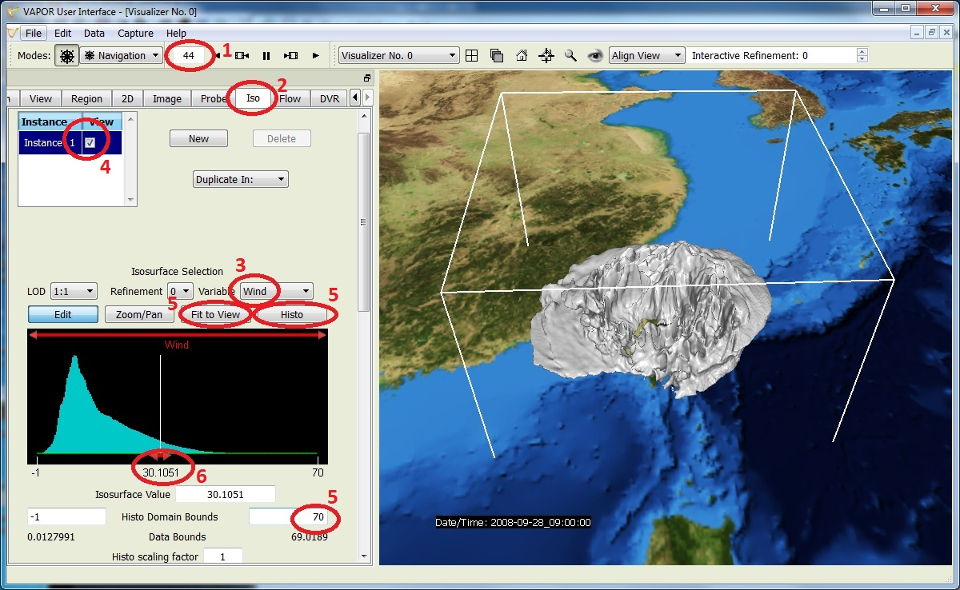
Isosurfaces of Wind (1)
In the Iso tab:
Select variable “Wind”
Check “Instance:1” to enable
Set histo right bound to 70, then “Fit to View” and “Histo” to see Wind histogram
Set the isovalue near 30 (use slider or type it in)
In the DVR tab: disable DVR (un-check Instance: 1)
Using VCR control:
Set current time step to 44
Click on Iso tab
Notes:
slide17.jpg

Slide 30
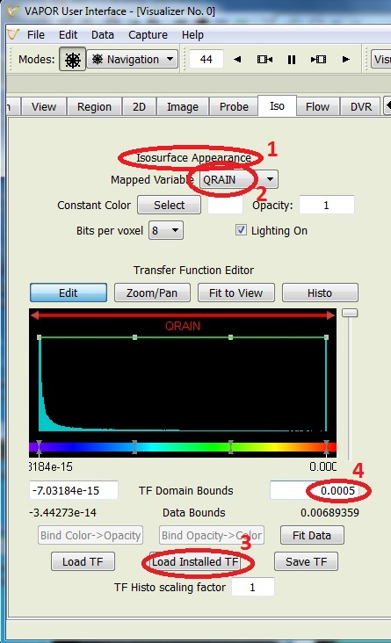
Isosurfaces of Wind (2)
To color the isosurface of Wind by QRAIN (or other variable):
Scroll down in the Iso tab to the transfer function, under Appearance
Set the mapped variable to “QRAIN”.
Click the button “Load Installed TF” below the transfer function, and load “reversedOpaque.vtf”. This makes low values violet-blue, high values orange-red.
Set the right domain bound of the transfer function to 0.001, so that the large values of QRAIN will show up as red in the isosurface.
Animate from time step 20 to see the typhoon vortex pass over Taiwan
Enable the DVR to combine clouds, wind and rain in one visualization.
Notes:
slide18.jpg

Slide 31
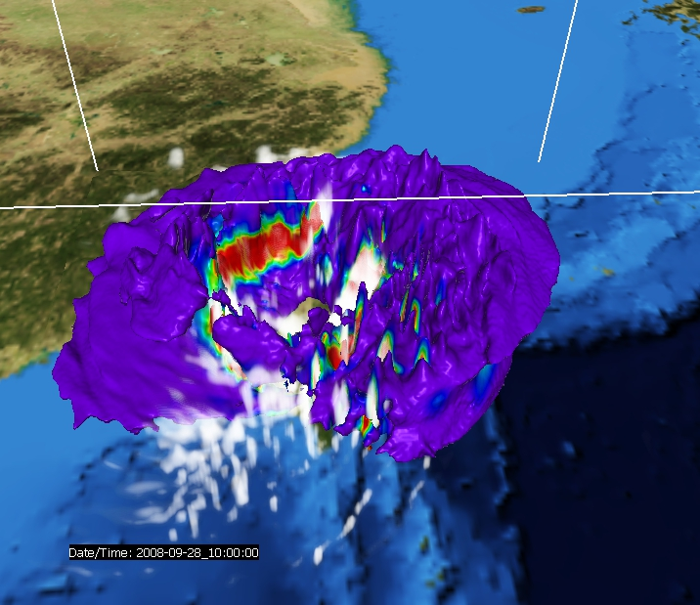
Isosurface of Wind = 30 at time step 45, colored by QRAIN, with volume render of QCLOUD
Notes:
Fig10.jpg

Slide 32
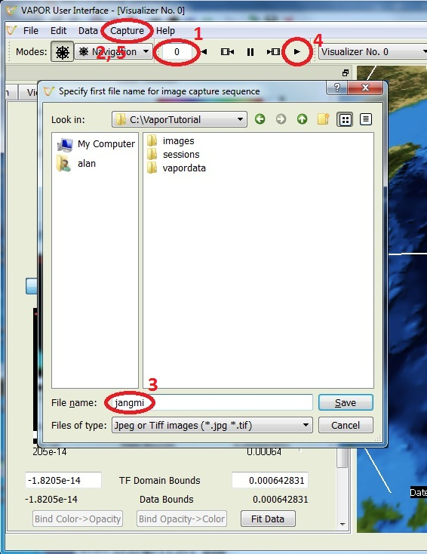
Capture an animation sequence
Save a sequence of jpeg files of your visualization:
Set the time step to 0
From Capture menu, choose “Begin image capture sequence…”
Choose a jpeg file name in a directory where you can write files.
Click the play ( ) button.
When animation is done, from the Capture menu, click “End flow capture sequence”
(Use Quicktime Pro, ffmpeg, etc. to convert to movie file.)
See jangmi.mov in images directory
Notes:
BE SURE to put jangmi.mov in directory

Slide 33
Use VAPOR/WRF python support
Vapor includes Python routines for weather analysis, such as radar reflectivity, sea-level pressure, cloud-top temperature, potential vorticity… (Documented on the VAPOR Website under “Data analysis with VAPOR”)
Disable the DVR and the Isosurface. Set time step = 30.
Write a Python script to create a new variable “dbz” which represents the simulated radar reflectivity. The python script consists of the two lines:
import vapor_wrf
dbz = vapor_wrf.DBZ(P,PB,QRAIN,0,QSNOW,T,QVAPOR)
Specify that dbz is an output 3D variable
Specify that P, PB, QRAIN, QSNOW, T, and QVAPOR are input 3D variables.
Visualize the DVR of dbz (click Fit Data and click “fit to view”)
Reduce opacity slider to its center position
Compare this with rain, by creating an isosurface of QRAIN=5.e-05, set the isosurface color to be Constant (white).

Slide 34
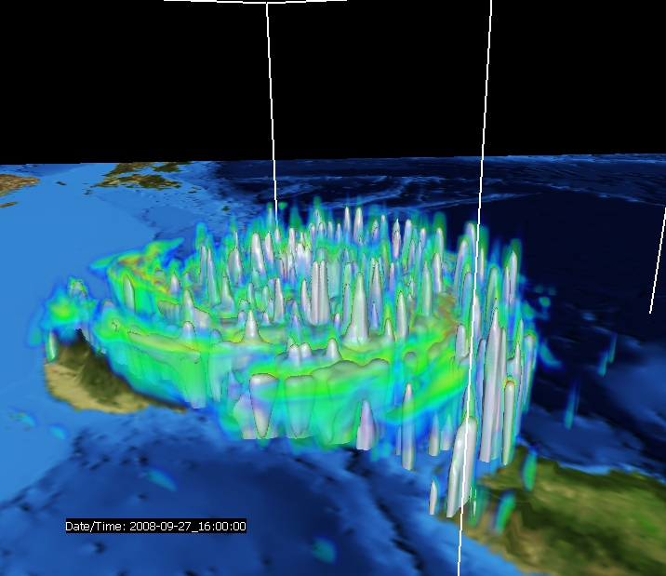
Radar reflectivity with isosurface of QRAIN as Typhoon Jangmi approaches Taiwan
Notes:
Use slide22.jpg

Slide 35
Calculate 2D Radar Reflectivity
Disable the Iso and the DVR.
Write a Python script to create a new variable “dbz2d” which represents the vertical max radar reflectivity. The python script consists of the two lines:
import vapor_wrf
dbz2d=vapor_wrf.DBZ_MAX(P,PB,QRAIN,0,QSNOW,T,QVAPOR)
Specify that dbz2d is an output 2D variable
Specify that P, PB, QRAIN, QSNOW, T, and QVAPOR are input 3D variables.
Click “Test” and then “Apply”
Notes:
Leave this and the following as exercise if time is short.

Slide 36
Visualize 2D Radar Reflectivity
Disable the DVR and the ISO renderers
Select 2D tab, choose “dbz2d” as variable
Click “Fit Data” , “Fit to View” and “Histo” buttons for the 2D transfer function editor.
Slide the leftmost control point down to the bottom so that zero reflectivity will display as transparent.
Enable the 2D visualizer (check Instance: 1)
Set the z coordinate of the 2D plane to 500 (just above the surface)
Enable the ISO visualizer, set its Opacity to 0.5, so you can compare the rain to the radar in the planar image

Slide 37
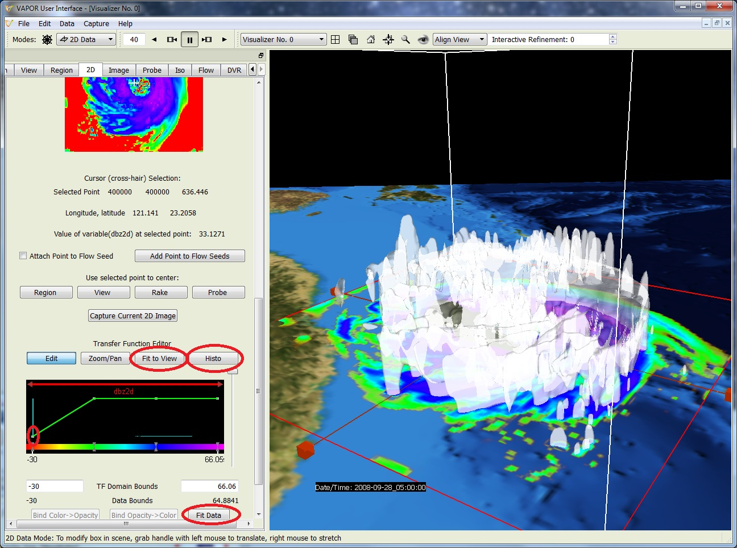
2D Radar Reflectivity with QRAIN isosurface

Slide 38
Flow Visualization Overview
Flow direction can be illustrated using the Barbs tab.
Flow can be illustrated in cross-section using the flow image capability in the Probe tab.
Vapor can display streamlines (steady flow, constant time) and pathlines (unsteady flow, showing particle paths over time)
Streamlines and path lines are established by seed points (starting points for flow integration)
Seed points can be:
Random: Randomly placed within a range of x, y, and z values, or
Nonrandom: Evenly spaced in x, y, and z dimensions, or
Seed List: Explicitly placed in the scene
Vapor Rake tool is provided to specify a box for random or evenly spaced (nonrandom) seeds (looks like: )
VAPOR Probe tool ( ) can be used to position flow seed points.

Slide 39
Display wind barbs
Disable the ISO and the 2D renderer
Click on the “Barbs” tab at the far left of the tabs
Enable the Barbs (you should see arrows spiraling around the typhoon
Under Layout Options, check “Offset vertical position by terrain height”, and set the X and Y grid dimensions to 20
Under Appearance options, set the Barb thickness to 1.5 and the scale factor to 1500
Enable the DVR of QCLOUD (retain previous DVR settings)
Animate.

Slide 40
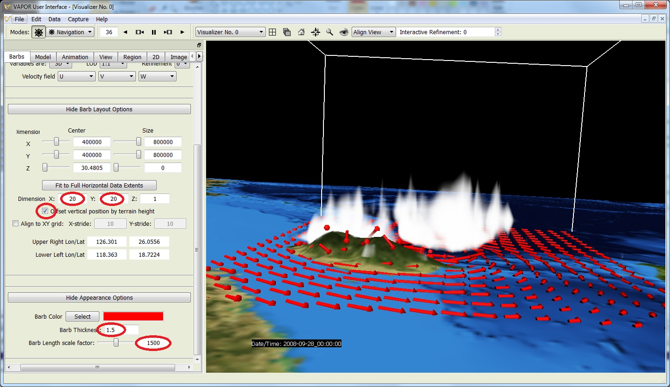
Wind Barbs with QCLOUD

Slide 41
Flow images
Flow can be visualized in planar cross-section using the “Flow Image” capability in the Probe.
Disable the Barbs and the DVR.
Click on the Probe arrow( ) in the Mode settings.
In the Probe tab, set Probe Type to “Flow Image”
Under Probe Layout options, click “Fit to Region”
Grab the middle handle of the probe with the right mouse and drag it down near the ocean (say 1000m)
Enable the probe
Animate the flow in the Probe Image settings by clicking the “Play” button “►”
Note the vortex location at frames 42-44 using probe cursor

Slide 42
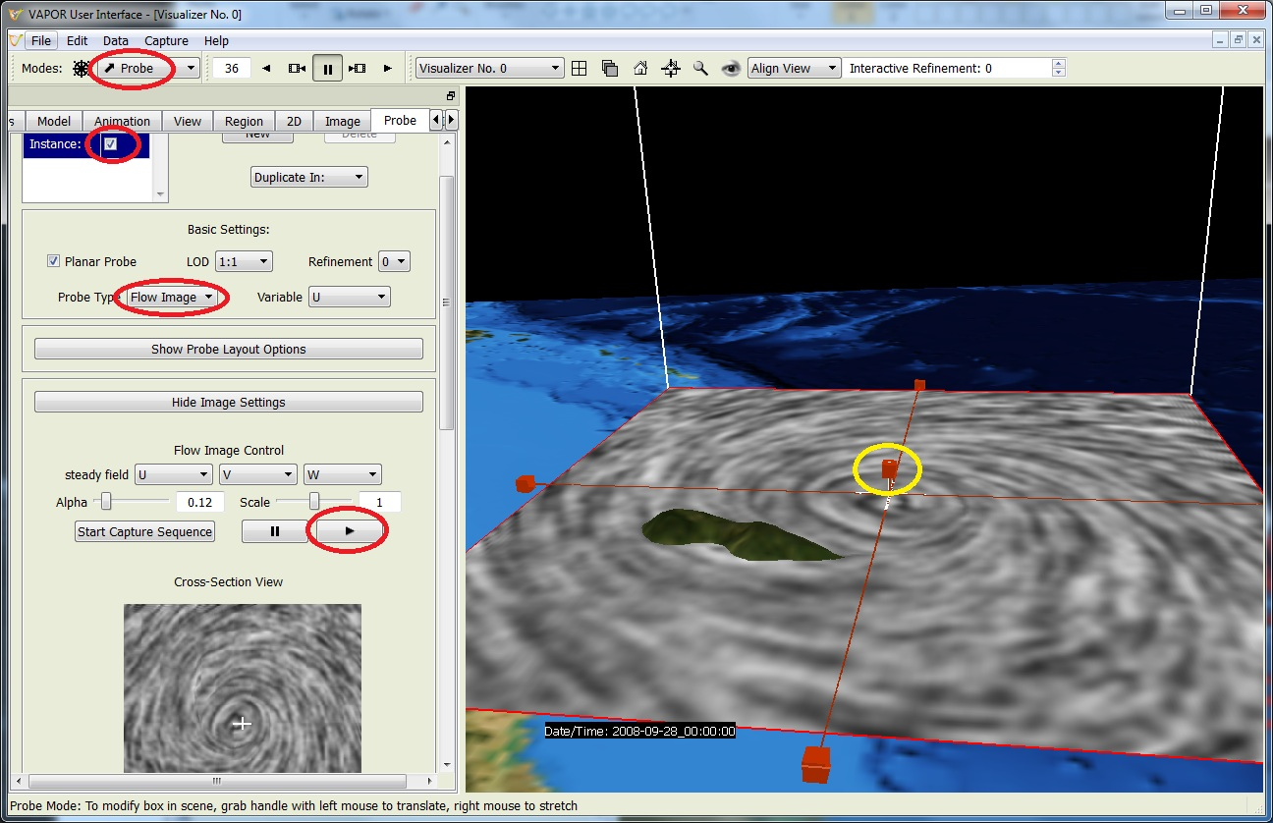
Flow image of Jangmi in horizontal plane

Slide 43
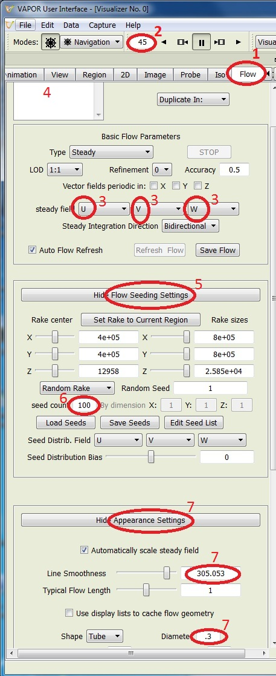
Random streamlines (1)
Disable Probe
Click on Flow tab
Set time step to 45
In flow tab, select U, V, W as steady field variables.
Check “Instance: 1” to enable steady flow (streamlines). Ignore the warning message.
Click “Show Flow Seeding Settings”
Specify seed count 100 (random) for steady flow, press <enter> to set the value.
Under Appearance settings, adjust smoothness (~300) and diameter (~0.3)

Slide 44
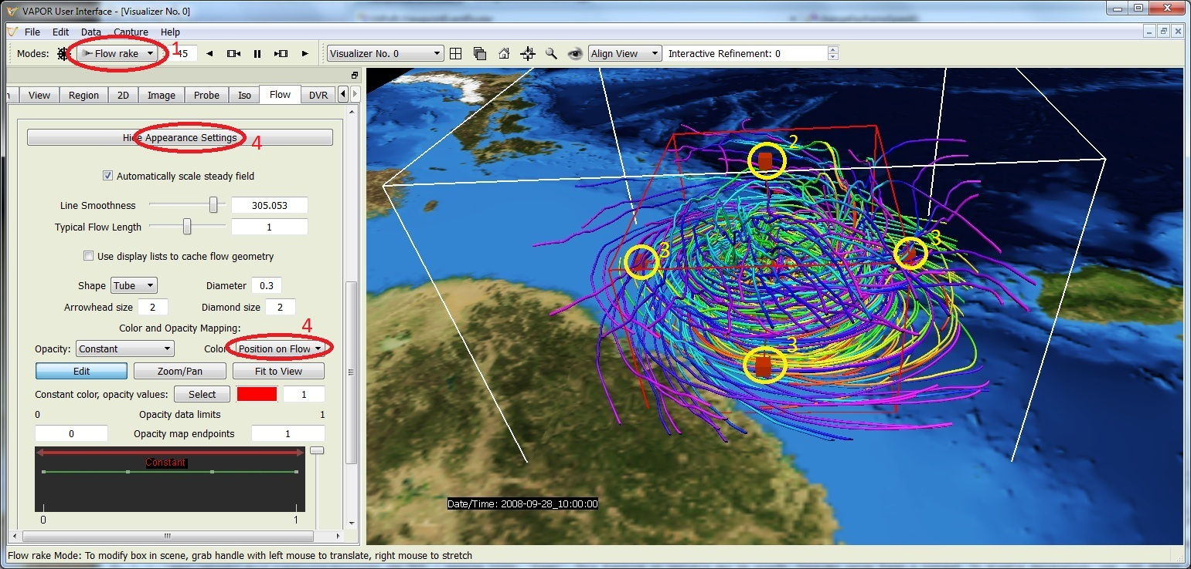
Random streamlines (2), using Rake
Select flow rake ( at top left, Mode selector). Note box and handles.
Grab the top handle of the rake with the right mouse button, pull it down about 1/3 of the way down (the flow seeds will be nearer the ground.)
Using the right mouse button, shrink the rake to a smaller box enclosing the eye of the typhoon
Color flow lines according to “position on flow” (in Appearance settings)
See how the wind is drawn in at ground level and climbs through the eyewall
fig12.vss
Notes:
slide25.vss

Slide 45
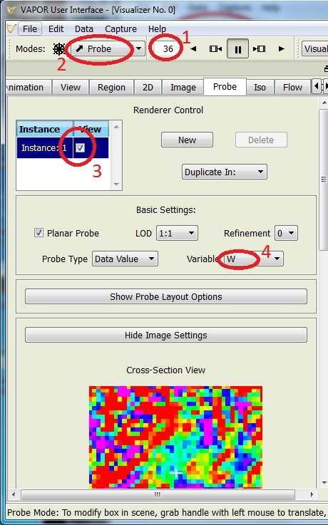
Use the probe to see a vertical slice of W (1)
Probe is useful to investigate the wind flow near the eye of the typhoon, by placing seed points where the W field is strongest
Disable the flow (uncheck Instance:1 box in Flow tab)
Set the time step to 36
Select Probe mode( ) in the Mode selector at the top. Select Probe Type to Data Value
Enable probe (check Instance:1 box in Probe tab)
Set the Probe variable to “W”

Slide 46
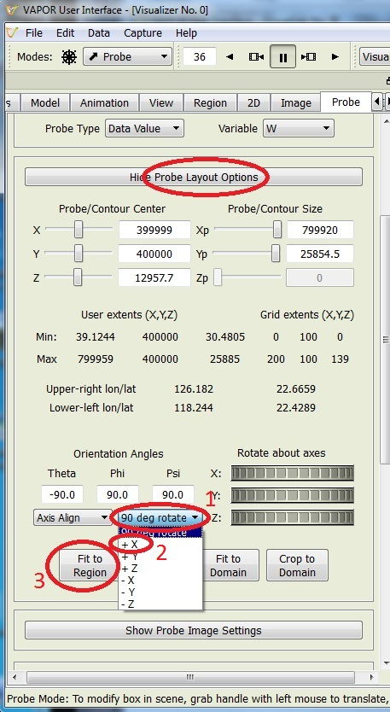
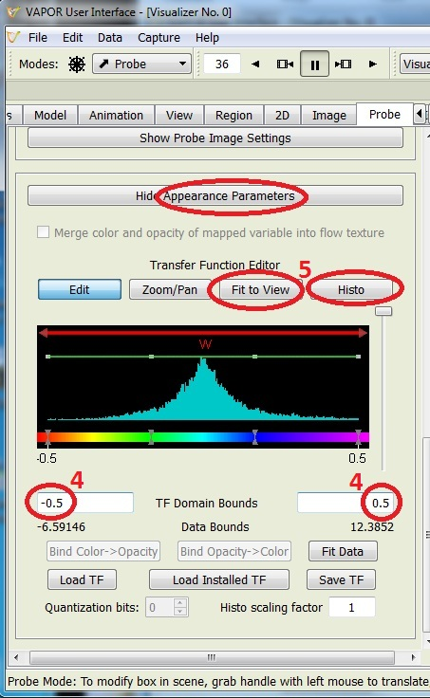
Using the probe to see a vertical slice of W (2)
To view a vertical slice through the typhoon:
Under “Probe Layout options”:
Click 90 degree rotate
Select “+X” to get a vertical slice.
Click “Fit to Region” button
In Appearance Parameters at the bottom of the probe panel:
Set the TF domain bounds to -0.5 and 0.5
Click “Fit to view” and “Histo” to see the values of W in the probe

Slide 47
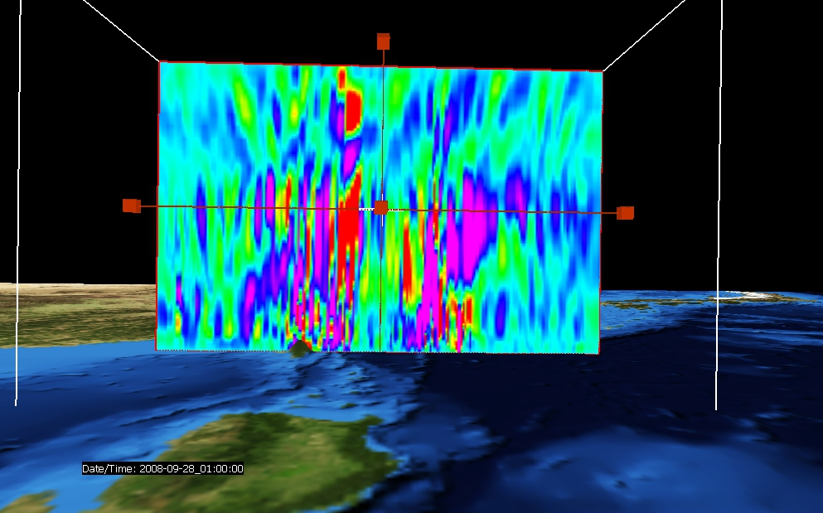
Cross section of typhoon (Probe of W) Viewed from the south
Notes:
slide28.vss

Slide 48
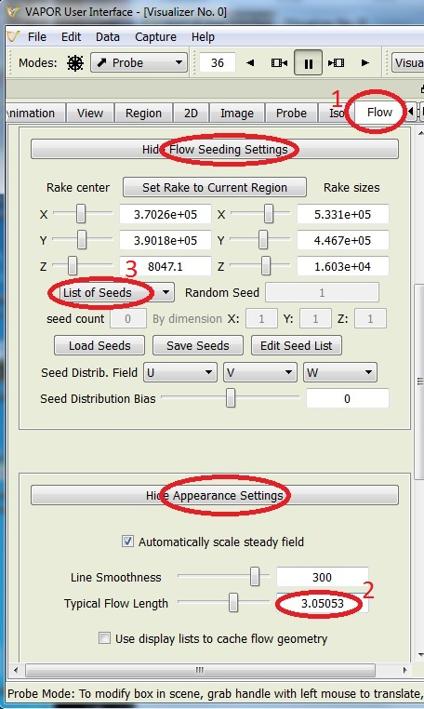
Using the probe to specify flow seed points (1)
Click on the Flow tab
Under Appearance Settings, set Typical Flow Length = 3
On the flow tab, under “flow seeding settings”, select “List of Seeds” instead of “Random Rake”.
Check “Instance:1” to enable the flow. Ignore the warning messages (there are no seeds in the list).

Slide 49
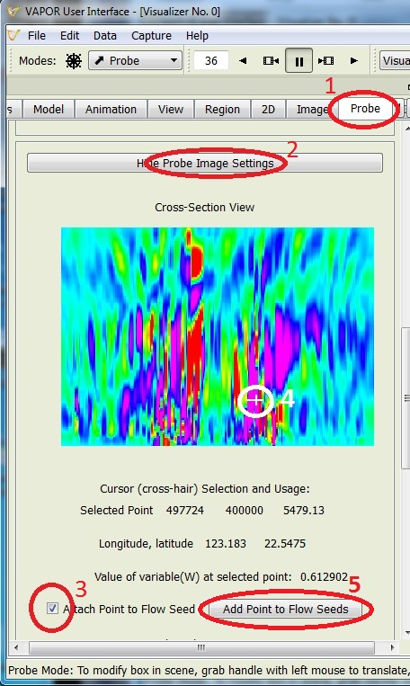
Using the probe to specify flow seed points (2)
Click on the probe tab.
Scroll down to the probe image settings, where you see an image of the cross-section of the data
Check “Attach point to flow seed”. You should see a streamline associated with a seed point at the cursor position.
Click mouse in the image, at positions with large (purple) W values, and see the streamlines associated with the eye wall.
Click “Add Point to Flow Seeds” for streamlines that you want to keep.
With 10-15 flow seeds you can visualize the wind flow pattern near the eye wall.

Slide 50
Streamlines placed with the probe
Notes:
Be sure to maximize and zoom in. Do NOT play forward or backward! W is bad in many time steps in this dataset.

Slide 51
Unsteady Flow
VAPOR also supports visualization of pathlines (particle traces). Users can visualize the trajectories massless particles would follow (forwards or backwards in time).
ERICA IOP simulation was an intense Atlantic marine cyclone occurring in January 1989, as powerful as a Category 3 or 4 hurricane. Mel Shapiro and Ryan Maue provided the data which is visualized in VAPOR:
Instructions for visualizing unsteady flow in VAPOR are provided in the tutorials on the VAPOR website, especially the “Georgia Weather Case Study” and the “Vapor Quick Start Guide”

Slide 52
Animation Control
A new feature in VAPOR 2.2 (not yet released)
Permits users to create animations where the viewpoint and the data time step are controlled by the user.
User specifies a sequence of keyframe viewpoints, VAPOR interpolates between them.
Example: Esperanza fire simulation, Janice Coen, NCAR
Camera is animated during the simulation to enable users to see most important details of a wildfire.

Slide 53
Ocean model visualization demo
VAPOR 2.2, to be released soon, will also support visualization of ocean models, including MOM, POP, and ROMS.
Development was supported by KISTI
Demonstrations (VAPOR 2.2 is required to visualize these)
Global MOM model
Regional MOM model
2 Regional ROMS models

Slide 54
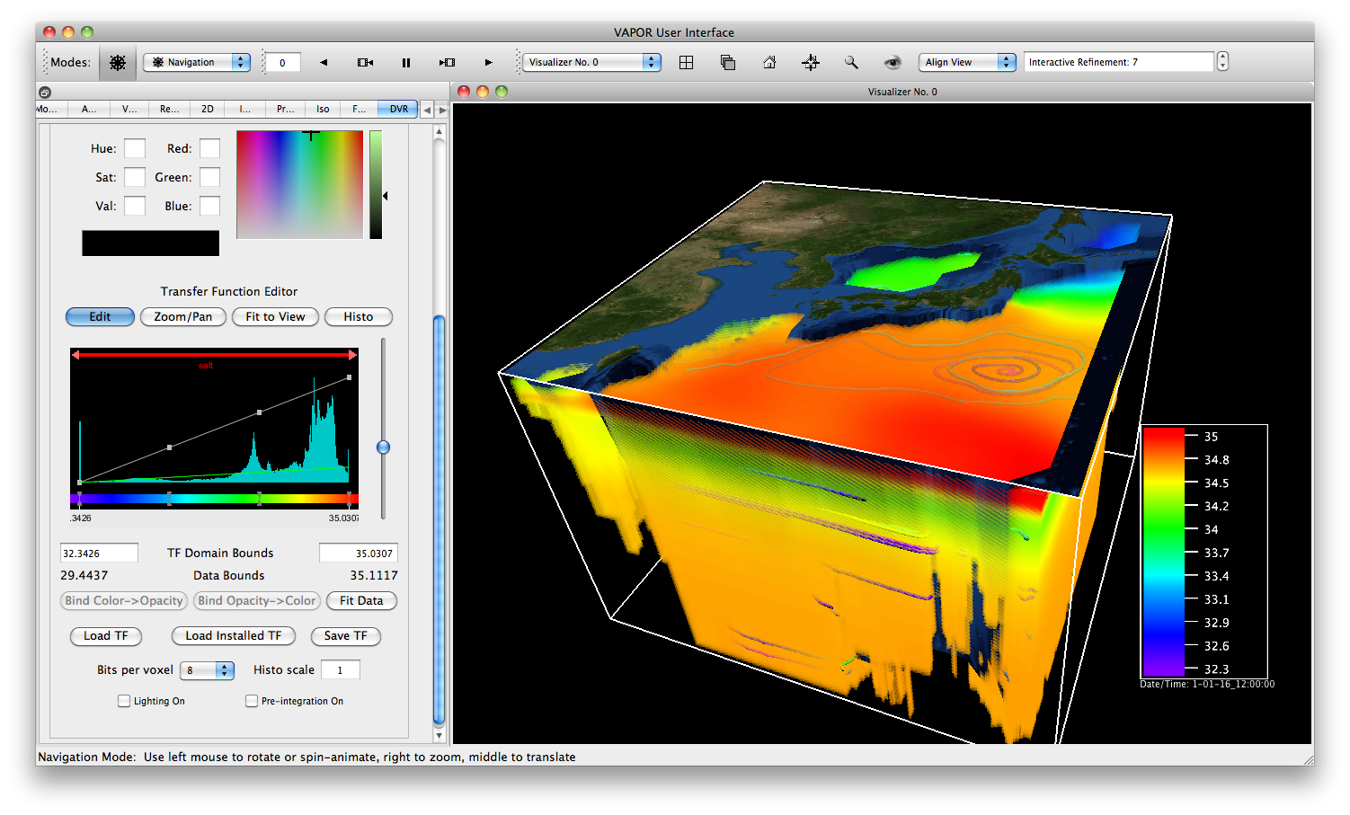
Regional ROMS model

Slide 55
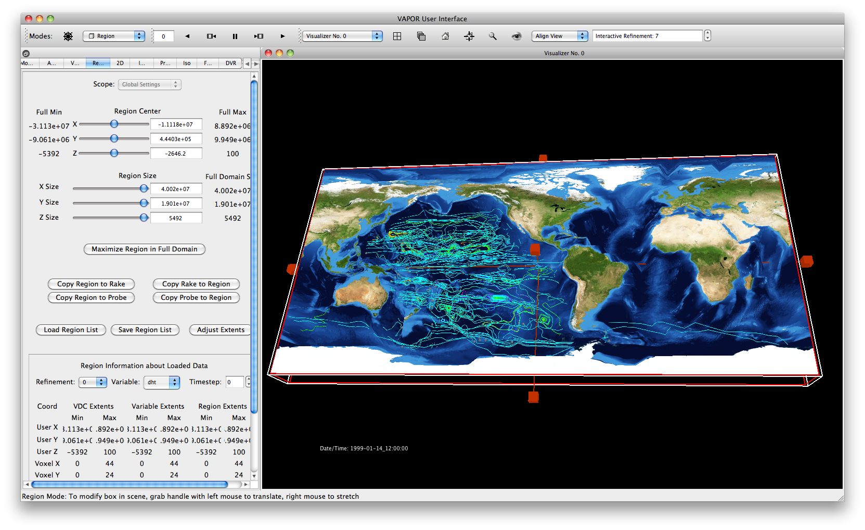
Global ROMS model

Slide 56
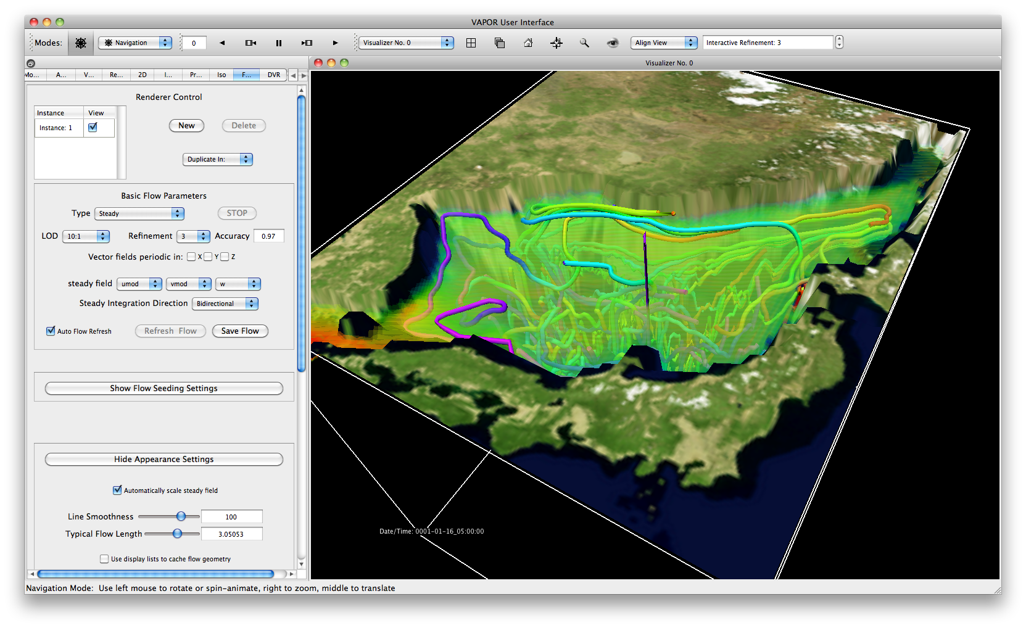
EastSea ROMS model

Slide 57
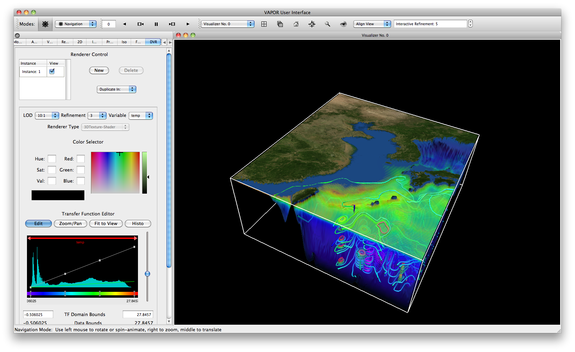
ROMS Rotated model

Slide 58
Questions?
Notes:
Cut if necessary

Slide 59
Acknowledgements
Steering Committee
Nic Brummell - UCSC
Yuhong Fan - NCAR, HAO
Aimé Fournier – NCAR, IMAGe
Pablo Mininni, NCAR, IMAGe
Aake Nordlund, University of Copenhagen
Helene Politano - Observatoire de la Cote d'Azur
Yannick Ponty - Observatoire de la Cote d'Azur
Annick Pouquet - NCAR, ESSL
Mark Rast - CU
Duane Rosenberg - NCAR, IMAGe
Matthias Rempel - NCAR, HAO
Geoff Vasil, CU
Leigh Orf, U Central Mich.
Systems Support
Joey Mendoza, NCAR, CISL
WRF consultation
Wei Wang – NCAR, MMM
Cindy Bruyere –NCAR, MMM
Yongsheng Chen-NCAR,MMM
Thara Prabhakaran-U. of Ga.
Wei Huang – NCAR/CISL
Minsu Joh - KISTI
Design and development
John Clyne – NCAR/CISL
Alan Norton – NCAR/CISL
Dan LaGreca – NCAR/CISL
Pam Gillman – NCAR/CISL
Kendall Southwick – NCAR/CISL
Markus Stobbs – NCAR/CISL
Kenny Gruchalla – NREL
Victor Snyder – CSM
Yannick Polius – NCAR/CISL
Karamjeet Khalsa – NCAR/CISL
Research Collaborators
Kwan-Liu Ma, U.C. Davis
Hiroshi Akiba, U.C. Davis
Han-Wei Shen, OSU
Liya Li, OSU

